Slide 1
Jack Was Every Inch a Sailor
Traditional Newfoundland and Labrador Folk Song

Slide 2
Info
Newfoundland and Labrador folk song
About a sailor/whaler
“tall tale” (like Drill Ye Tarriers)

Slide 3
Now t’was twenty five or thirty years
Since Jack first saw the light.
He came into this world of woe
one dark and stormy night.
He was born on board his father’s ship
As she was lying to
‘bout twenty five or thirty miles south east of Baccalieu.

Slide 4
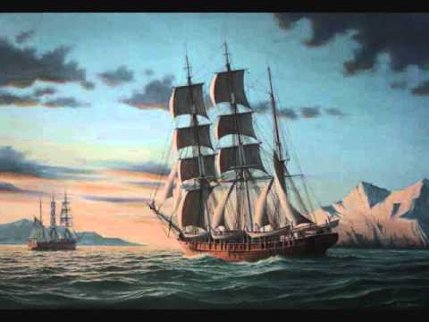
Oh Jack was every inch a sailor.
Five and twenty years a whaler.
Jack was every inch a sailor.
He was born up on the bright blue sea.

Slide 5
When Jack grew up to be a man
He went to Labrador,
He fished in Indian Harbour,
Where his father fished before.
On his returning in the fog,
He met a heavy gale,
And Jack was swept into the sea
And swallowed by a whale.

Slide 6
Oh Jack was every inch a sailor.
Five and twenty years a whaler.
Jack was every inch a sailor.
He was born up on the bright blue sea.

Slide 7
The whale went straight for Baffin’s Bay,
About ninety knots an hour.
And every time he’d blow a spray
He’d send it in a shower
O now says Jack unto himself,
I must see what he’s about
He caught the whale by the tail
And turned him inside out.

Slide 8
Oh Jack was every inch a sailor.
Five and twenty years a whaler.
Jack was every inch a sailor.
He was born up on the bright blue sea.

