Slide 1
Beginning Band
First Notes!

Slide 2
Expectations for Behaviour
RESPECT
The instrument/equipment.
Do not be rough with instruments/equipment.
Your teachers/peers.
Do not play during instructions.
Do not blast your instrument/blow in someone’s ear.
Be part of the team – ALWAYS.
Be kind to everyone – we are all learning at our own pace.
Yourself.
Learning an instrument is tough, don’t be too hard on yourself.

Slide 3
How to sit in band:
When we are playing, ALWAYS:
Sit tall
Feet flat on the floor
Facing the conductor
Chin is straight, not tucked or tipped back
If you have a stand, raise it to your height so you can see your music and the conductor at the same time.

Slide 4
How to breathe in band:
When we are playing, ALWAYS take big belly breaths.
Breathe down into your belly and expand your ribs outwards.
NOT your shoulders upwards.
Breaths should be big and fast through the MOUTH.
If your breath is noisy, you aren’t doing it right.

Slide 5
Sizzles:
Let’s practice good band breathing by sizzling.
In for one, out for four.
In for one, out for eight.
In for one, out for twelve.
In for one, out for sixteen!
In for one, out for as long as you can.
Wimpy sizzles don’t count.
Take breaks if you start to feel at all light headed. You’ll get better at this with practice.

Slide 6
Putting Instruments Together:
For now, we’ll go one group at a time until I know that you know how to do this correctly.
Mrs. Burke will check your assembly.
DO NOT play until you have been asked to do so.

Slide 7
Flutes
Twist all three pieces together GENTLY.
Don’t force anything.
The keys should line up with the tone hole.

Slide 8
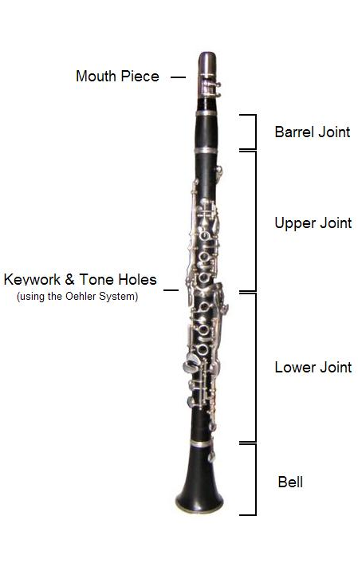
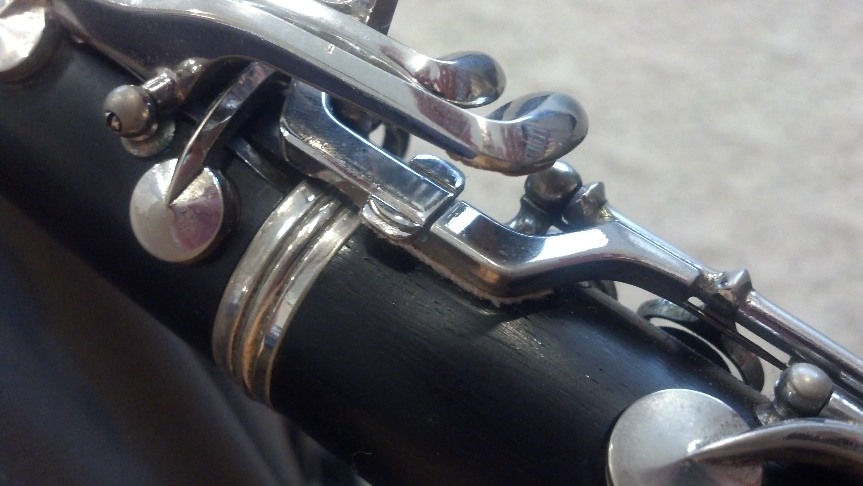
Clarinets
Twist pieces together GENTLY starting from the bottom (bell, lower joint, upper joint, barrel, mouthpiece, reed/ligature)
Be extra careful when putting together the upper and lower joints that you don’t jam the bridge keys together.

Slide 9
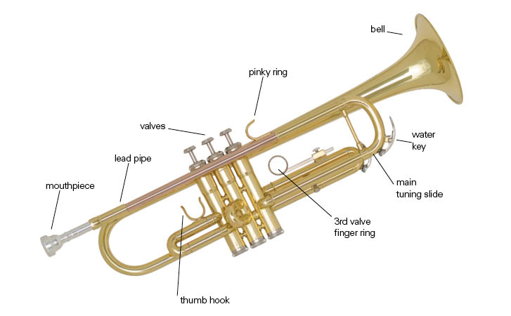
Trumpet
Gently twist the mouthpiece into the lead pipe.
DO NOT hit it or tap it. It will get stuck.

Slide 10
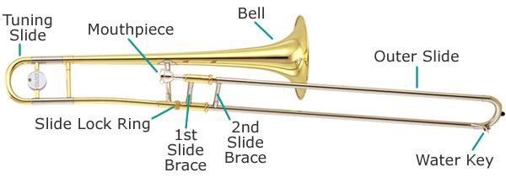
Trombone
Hold the slide in your right hand (long end towards your body)– make sure the slide is locked.
Pick the bell up in your left hand and screw it into the slide until it is snug.
Make an approximately 90-degree angle between the slide and the bell.
Gently insert the mouthpiece and twist to the right.
Do not hit or tap it. It will get stuck.

Slide 11
Holding The Instruments:
There are reasons for why we need to hold the instruments in a certain way.
Trust Mrs. Burke and don’t create your own ways that you think are better.

Slide 12
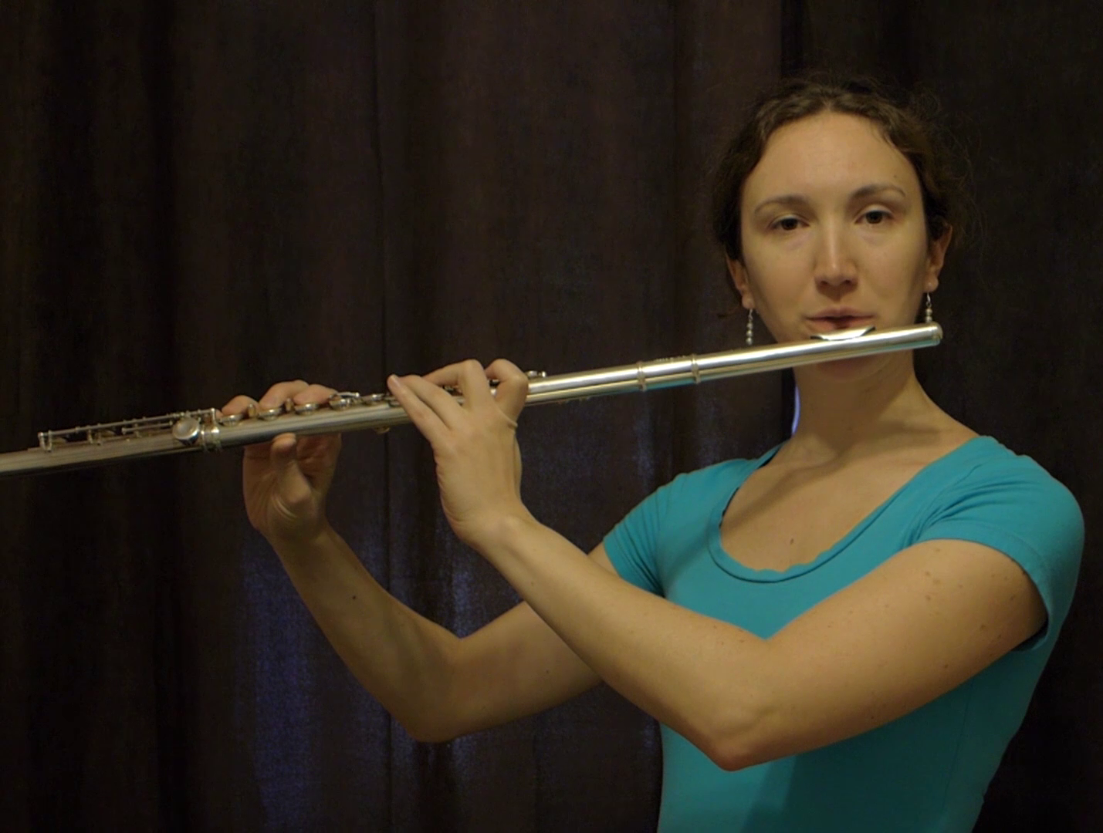
Flutes
Sit up tall on the edge of your chair. Feet flat on the floor.
Your left hand will hold the body.
Thumb goes on the longer key on the back.
“Skip one, yes, skip one, yes, yes”
Your right hand uses the keys closer to the foot.
“Pinky, yes, yes, yes”
Thumb rests under the flute between your pointer and middle fingers.
Your fingers should feel relaxed and curved. Elbows away from the body.
Hold the flute up to your lips, parallel to the ground.

Slide 13
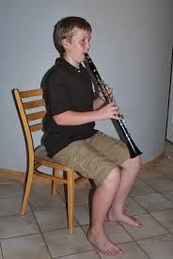
Clarinets
Sit up tall on the edge of your chair. Feet flat on the floor.
Put your right hand thumb underneath the thumb rest.
Put your left hand on the upper joint – thumb goes on the ring on the back, and first three fingers cover the rings on the front.
Hold the clarinet directly in front of you, between your knees, at about a 45 degree angle away from your body.
Your fingers should feel relaxed and curved. Elbows away from the body.

Slide 14
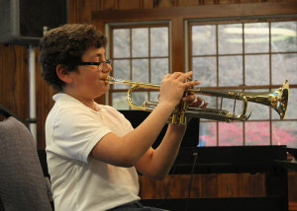
Trumpets
Sit up tall on the edge of your chair. Feet flat on the floor.
Hold the trumpet in your left hand. Wrap your fingers around the valves.
Place your left middle finger in the third valve ring.
Place your right thumb between the first and second valves, just below the lead pipe.
Place the tips of your right hand fingers on top of the valves. Fingers should be curved and relaxed.
Place your right hand pink on top of the “pinky ring” (not in it).
Elbows should be away from the body.

Slide 15
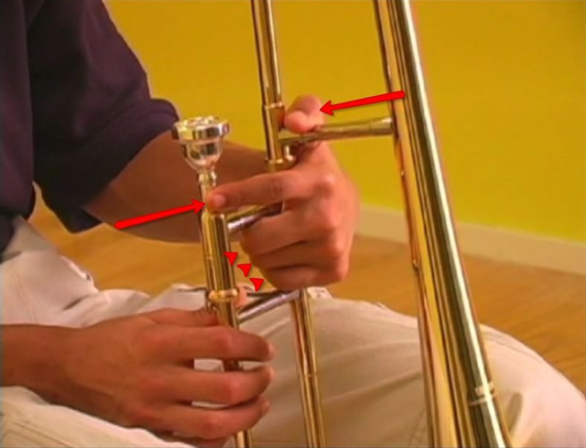
Trombones
Sit up tall on the edge of your chair. Feet flat on the floor.
Create a “spider man” shape with your left hand.
Put your left hand middle, ring, and pinky fingers in between the slide braces.
Put your left hand pointer on the mouthpiece.
Your thumb wraps around the remaining brace.
Use your right hand fingertips to hold the slide.
Two fingers on top, two on the bottom.
The instrument will rest slightly on your left shoulder.

Slide 16
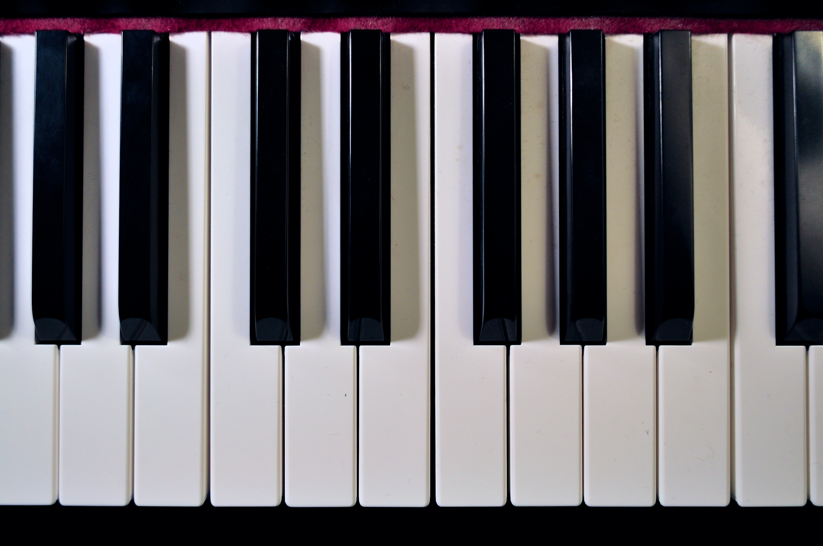
First Notes
Transposing Instruments
Trombones, Euphonium, Flute – whatever I say, you play
Trumpets, Clarinets – whatever I say, you move one WHOLE step higher
B-flat Concert = C for clarinets/trumpet
C Concert = D for clarinets/trumpets
D Concert = E for clarinets/trumpets
E-flat Concert = F for clarinets/trumpets
F Concert = G for clarinets/trumpets

Slide 17
First Notes/Echoes
First notes for French Horn:
F
G
A
B-flat
C
First notes for Trombone/Euphonium/Flutes:
B-flat
C
D
E-flat
F
First notes for Clarinet/Trumpets:
C
D
E
F
G

Slide 18
Apple Pie Warmup
Bb C I’m Going
Bb D To Bake
Bb Eb An Ap
Bb F Ple Pie!
FFFF Chop the Apples
Eb Eb Eb Eb Add The Sugar
D C Bb Roll The Dough
C D I’m Going
C E To Bake
C F An Ap
C G Ple Pie
GGGG Chop The Apples
FFFF Add The Sugar
EDC Roll The Dough

Slide 19
Hot Cross Buns
Trombone/Flute:
D C Bb
D C Bb
Bb Bb C C
D C Bb
Trumpet/Clarinet:
E D C
E D C
C C D D
E D C
Horn:
A G F
A G F
F F G G
A G F

Slide 20
Merrily We Roll Along
Tbone/Flute:
D C Bb C D D D
C C C
D D D
D C Bb C D D D
C C D C Bb
Horn:
A G F G A A A
G G G
A A A
A G F G A A A
G G A G F
Tpt/Clarinet:
E D C D E E E
D D D
E E E
E D C D E E E
D D E D C

Slide 21
Au Clair de la Lune
Bb Bb Bb C D C
Bb D C C Bb
Bb Bb Bb C D C
Bb D C C Bb
C C C D E D
C E D D C
C C C D E D
C E D D C

Slide 22
Mary Had a Little Lamb
D C Bb C D D D
C C C
D F F
D C Bb C D D D
C C D C Bb
E D C D E E E
D D D
E G G
E D C D E E E
D D E D C

Slide 23
Lightly Row
F D D
Eb C C
Bb C D Eb F F F
F D D
Eb C C
Bb D F F Bb
G E E
F D D
C D E F G G G
G E E
F D D
C E G G C

Slide 24
Ode to Joy
D D Eb F
F Eb D C
Bb Bb C D
D C C
D D Eb F
F Eb D C
Bb Bb C D
C Bb Bb
E E F G
G F E D
C C D E
E D D
E E F G
G F E D
C C D E
D C C
A A Bb C
C Bb A G
F F G A
A GG
A A Bb C
C Bb A G
F F G A
G F F

Slide 25
The Lion Sleeps Tonight
Bb C D C
D Eb D C Bb
C D C Bb D C
F D C D
F Eb D C Bb
C D C Bb C Bb
C D E D
E F E D C
D E D C E D
G E D E
G F E D C D E D C D C

Slide 26
Twinkle Twinkle Little Star
Bb Bb F F G G F
Eb Eb D D C C Bb
F F Eb Eb D D C
F F Eb Eb D D C
Bb Bb F F G G F
Eb Eb D D C C Bb
C C G G A A G
F F E E D D C
G G F F E E D
G G F F E E D
C C G G A A G
F F E E D D C

Slide 27
Blues Chord Progression
Bb Bb Bb Bb
Eb Eb Bb Bb
F Eb Bb Bb
C C C C
F F C C
G F C C

Slide 28
Taking Instruments Apart:
Flutes/Clarinets – use your cleaning swab to remove moisture.
Brass – empty your water keys (spit valves) into the garbage can.
NOT onto the floor or in your case. Ew.
Gently twist the pieces apart and put them in your case.
Each piece has an exact spot. Do not rush and do not force anything.
Get Mrs. Burke to check your case before you close it if you aren’t sure.

