Slide 1
Band Basics
Name:____________________________
Instrument:_______________________
Band Locker #:___________________

Slide 2
Clefs/The Staff
*The staff follows the musical alphabet.
Just keep saying your alphabet forwards or backwards to find the note you need!
Lines: Granny Brown Died Fighting Alligators
Spaces: All Cows Eat Grass
Lines: Ernie Gives Barnie Dog Food
Spaces: FACE in the Space
Treble Clef – Used for higher notes
Bass Clef – used for lower notes

Slide 3
Accidentals
Sharp – Raises a note by a half step (semitone)
Flat – Lowers a note by a half step (semitone)
Natural – Cancels a flat or sharp *This means it can raise AND lower notes.
Double Sharp – Raises a note by a whole step
Double Flat – Lowers a note by a whole step
Accidentals last for an entire bar. Bar lines cancel them.

Slide 4
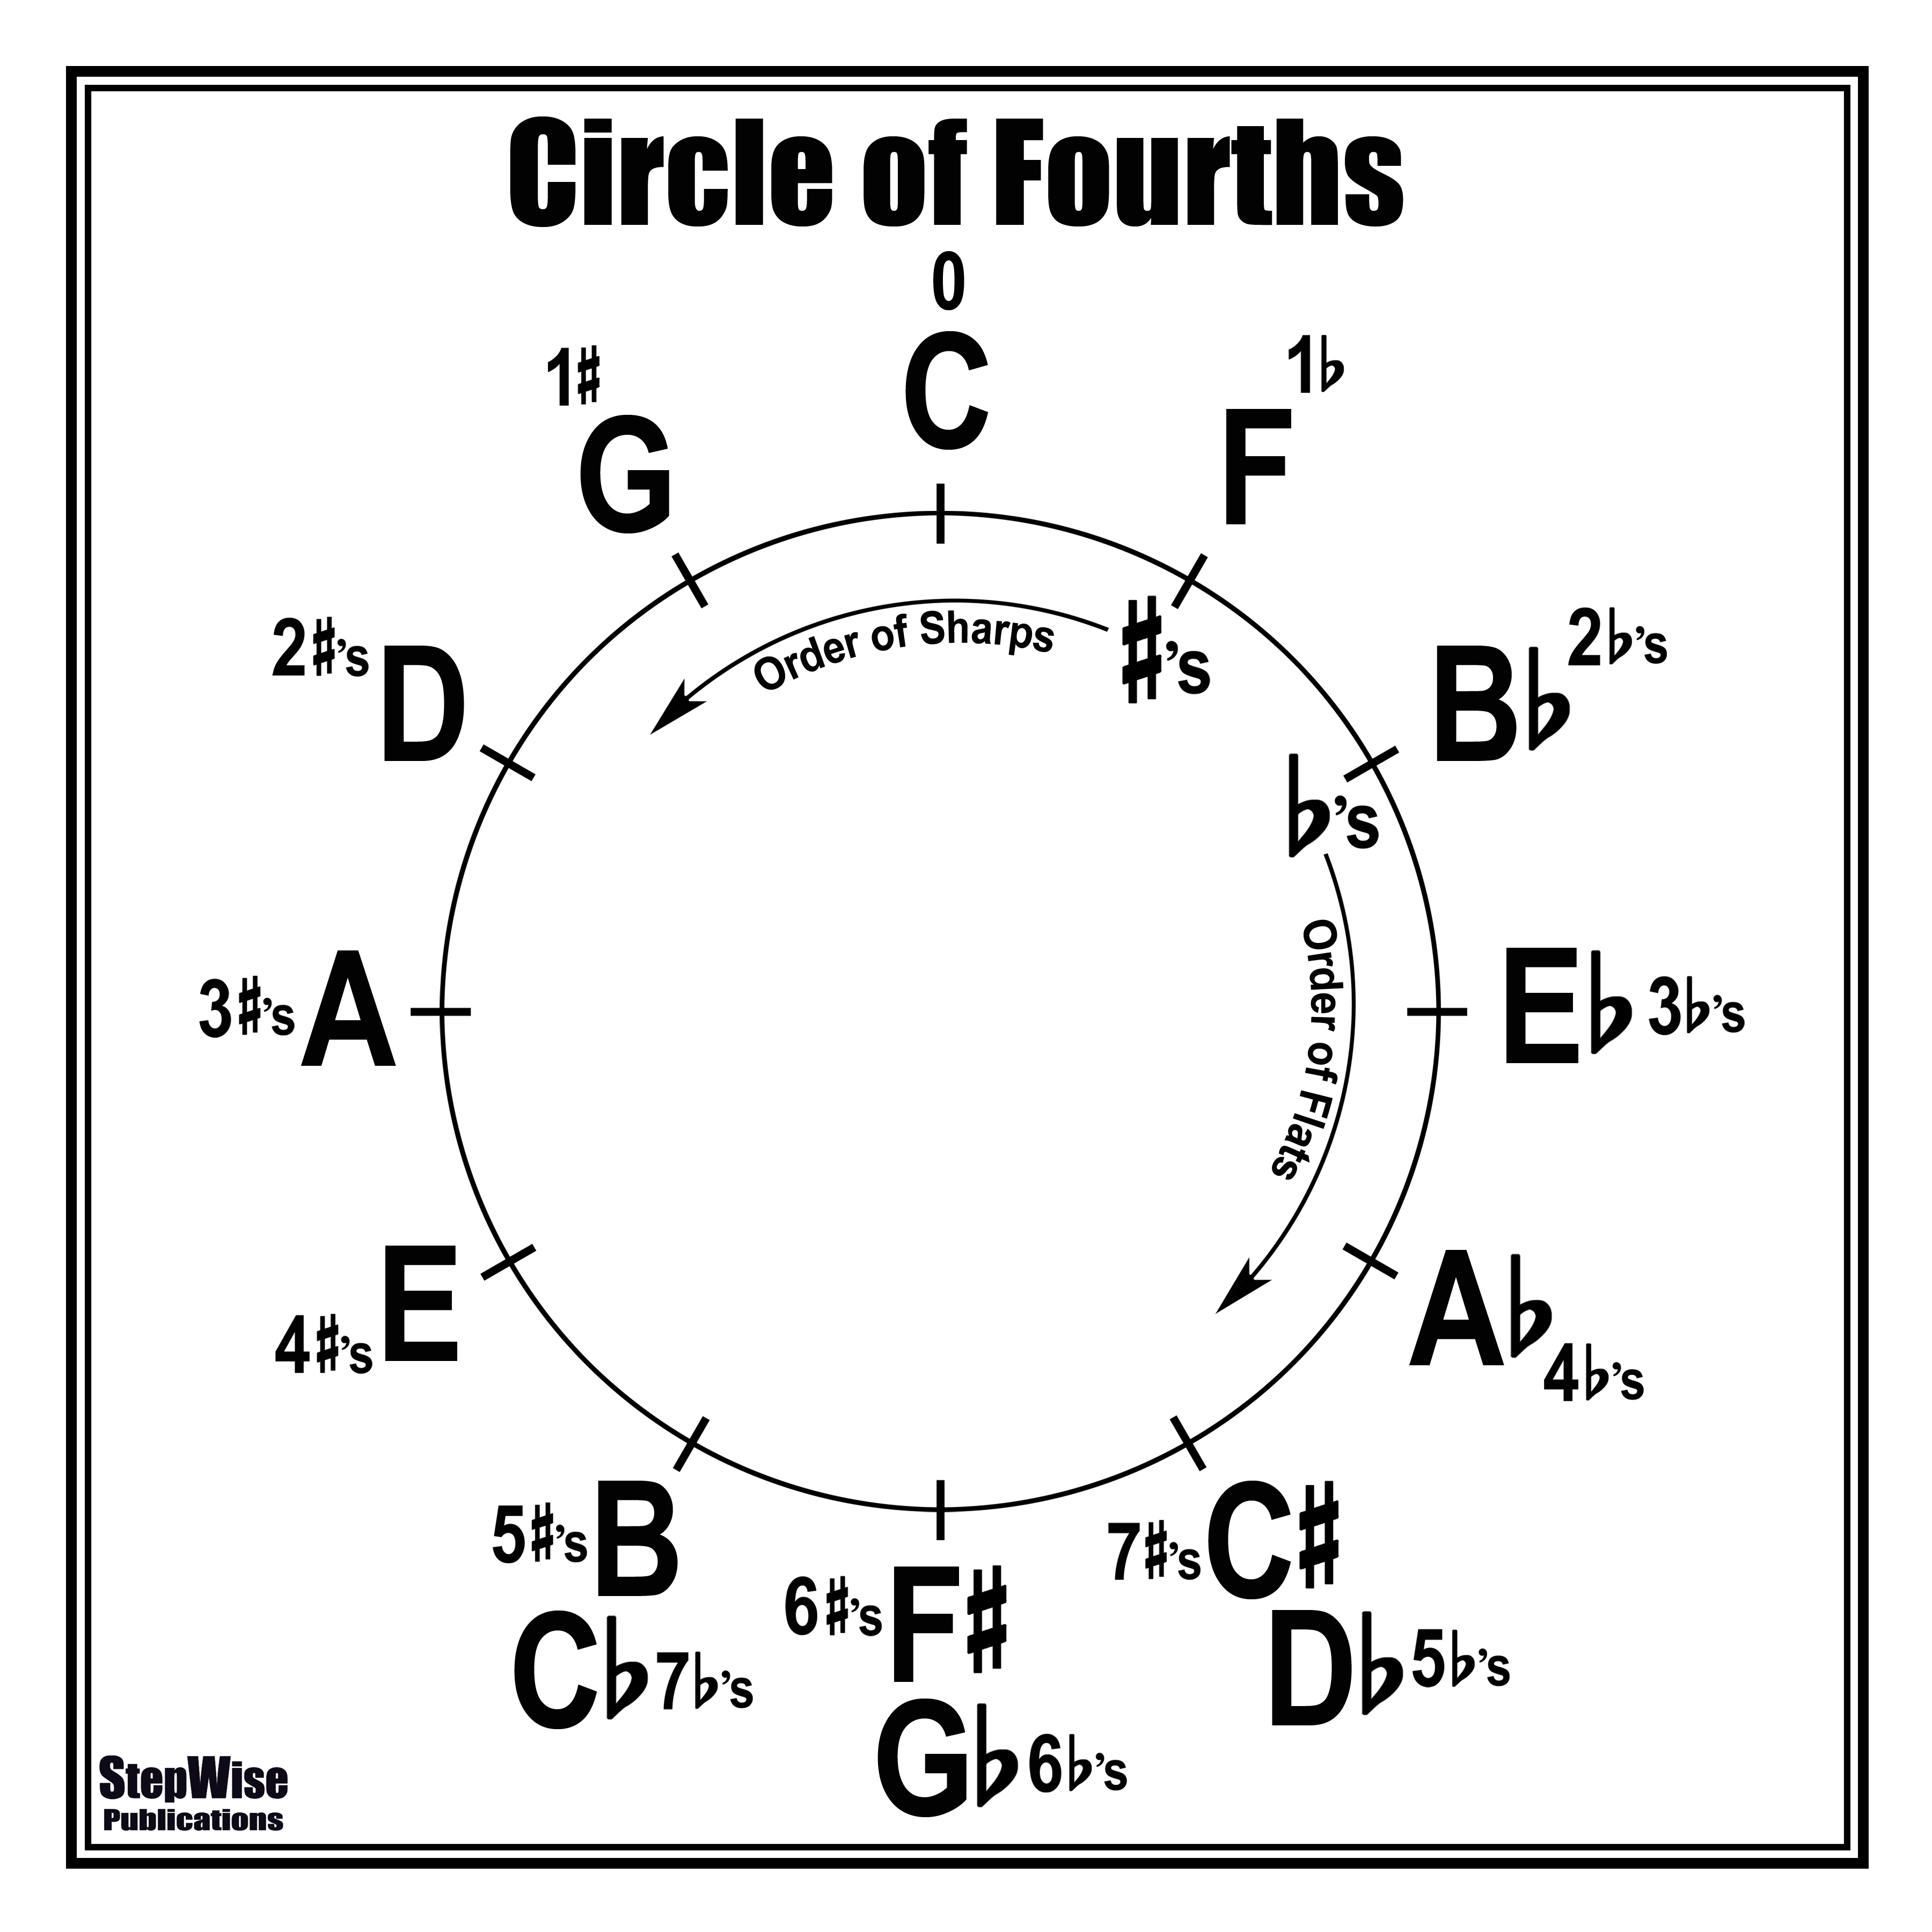
Circle of Fourths

Slide 5
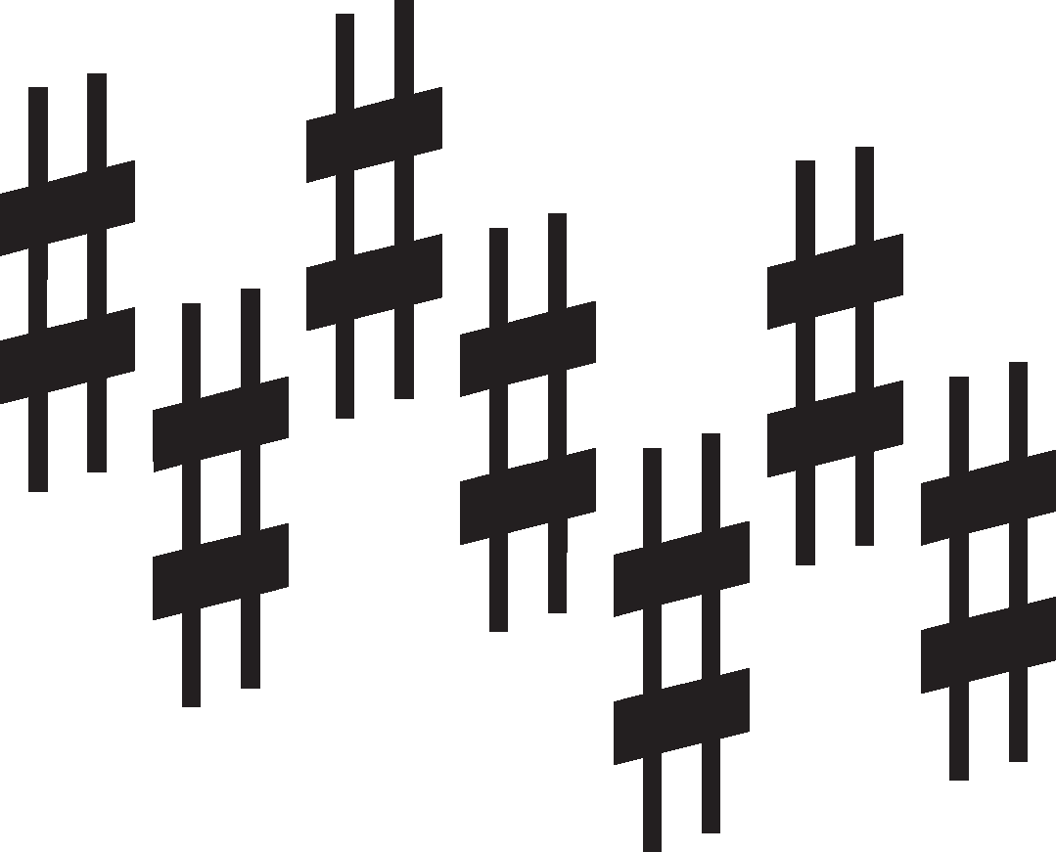
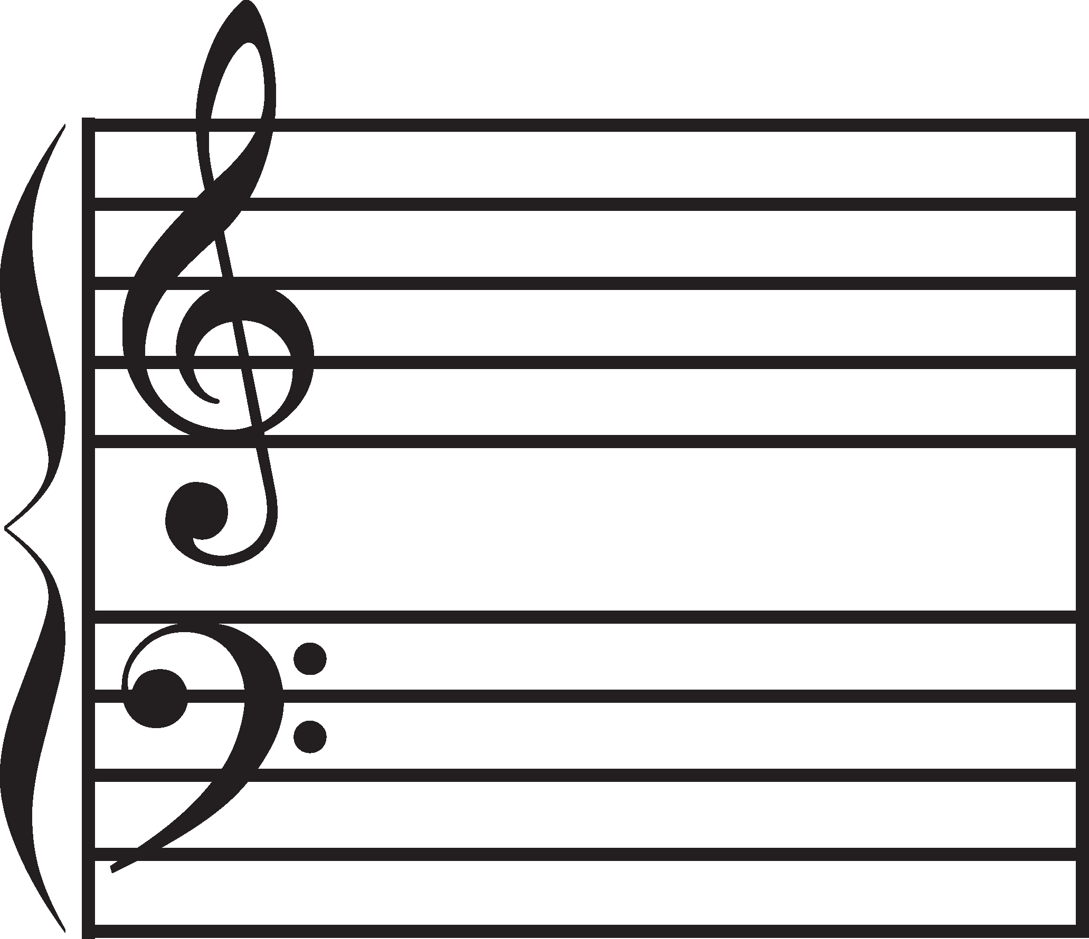
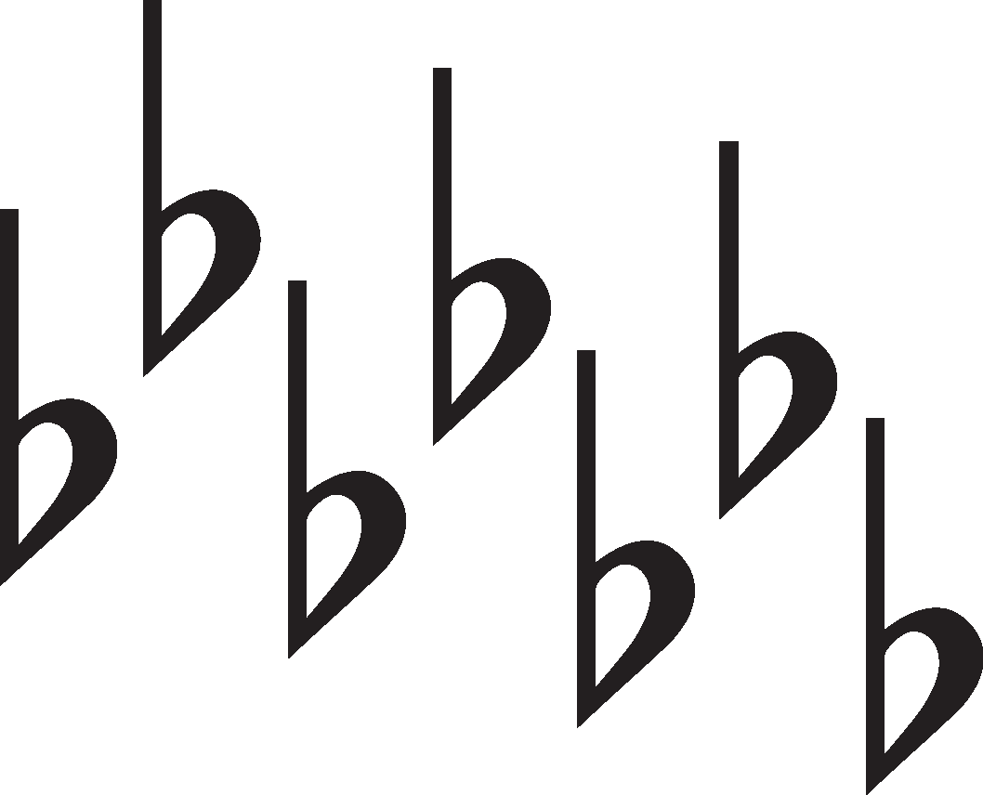
Key Signatures
*Sharps and flats in key signatures will always show up in the same order and are always written on the same lines/spaces.
*That means if you see 6 flats you automatically know what they are. Or, if you see 7 sharps, you will automatically know what they are.
*Key signatures tell you which notes you should always play flat or sharp in a piece and let us know what key a piece is written in.
Order of Sharps: F# C# G# D# A# E# B# Father Charles Goes Down And Eats Breakfast
Order of Flats: Bb Eb Ab Db Gb Cb Fb BEAD Greatest Common Factor
*The order of sharps and order of flats are the reverse of each other.

Slide 6
Key Signatures (Cont.)
Flat Key Signatures: *The second last flat in a key signature is the name of the major key.
*The name of a major key, plus one more flat will be all of the flats found in the key signature.
* F Major has one flat. (Memorize this one.)
Sharp Key Signatures: *The last sharp in the key signature plus two more from the order of sharps is the name of the key.
OR
*A semitone higher than the last sharp is the name of the key.
*The name of the major key then back two in the order of sharps will be the last sharp in the key signature.
OR
*The name of the key signature then back one semitone is the last sharp in the key signature.
*C Major has no flats or sharps. (Memorize this one.)

Slide 7
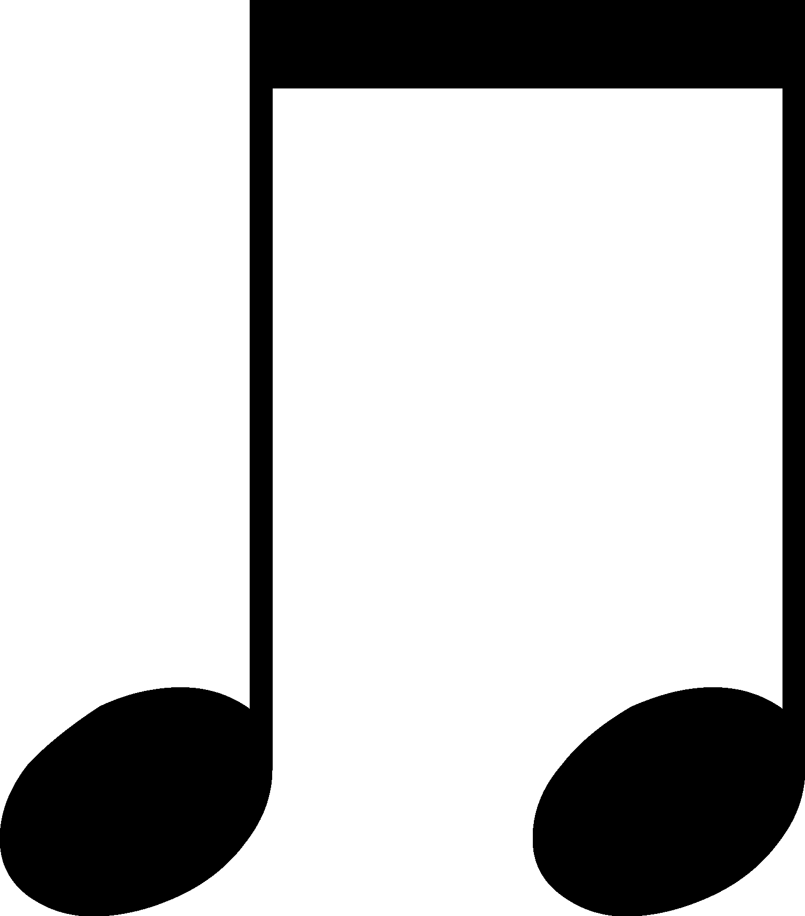
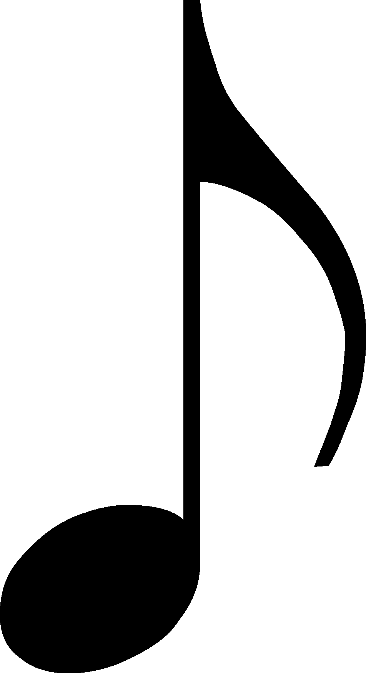
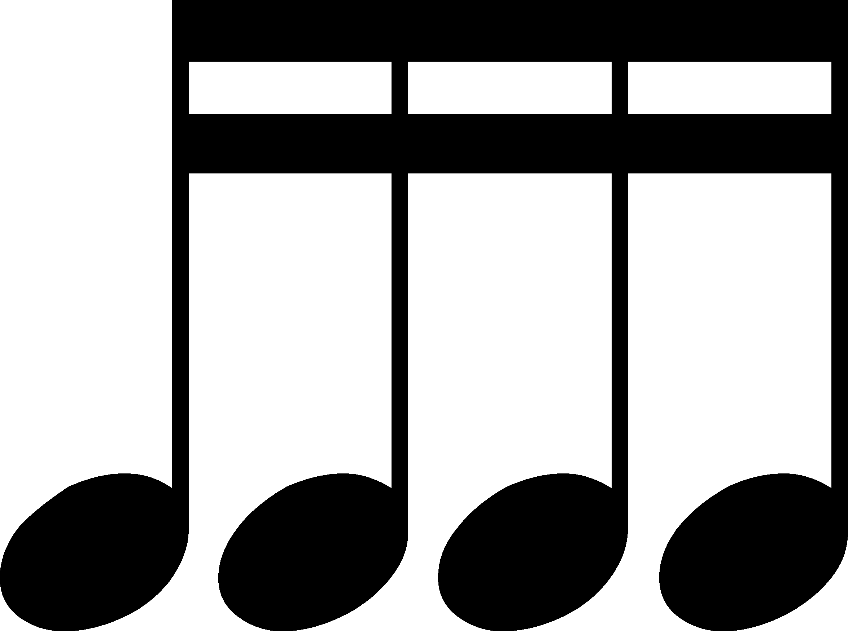
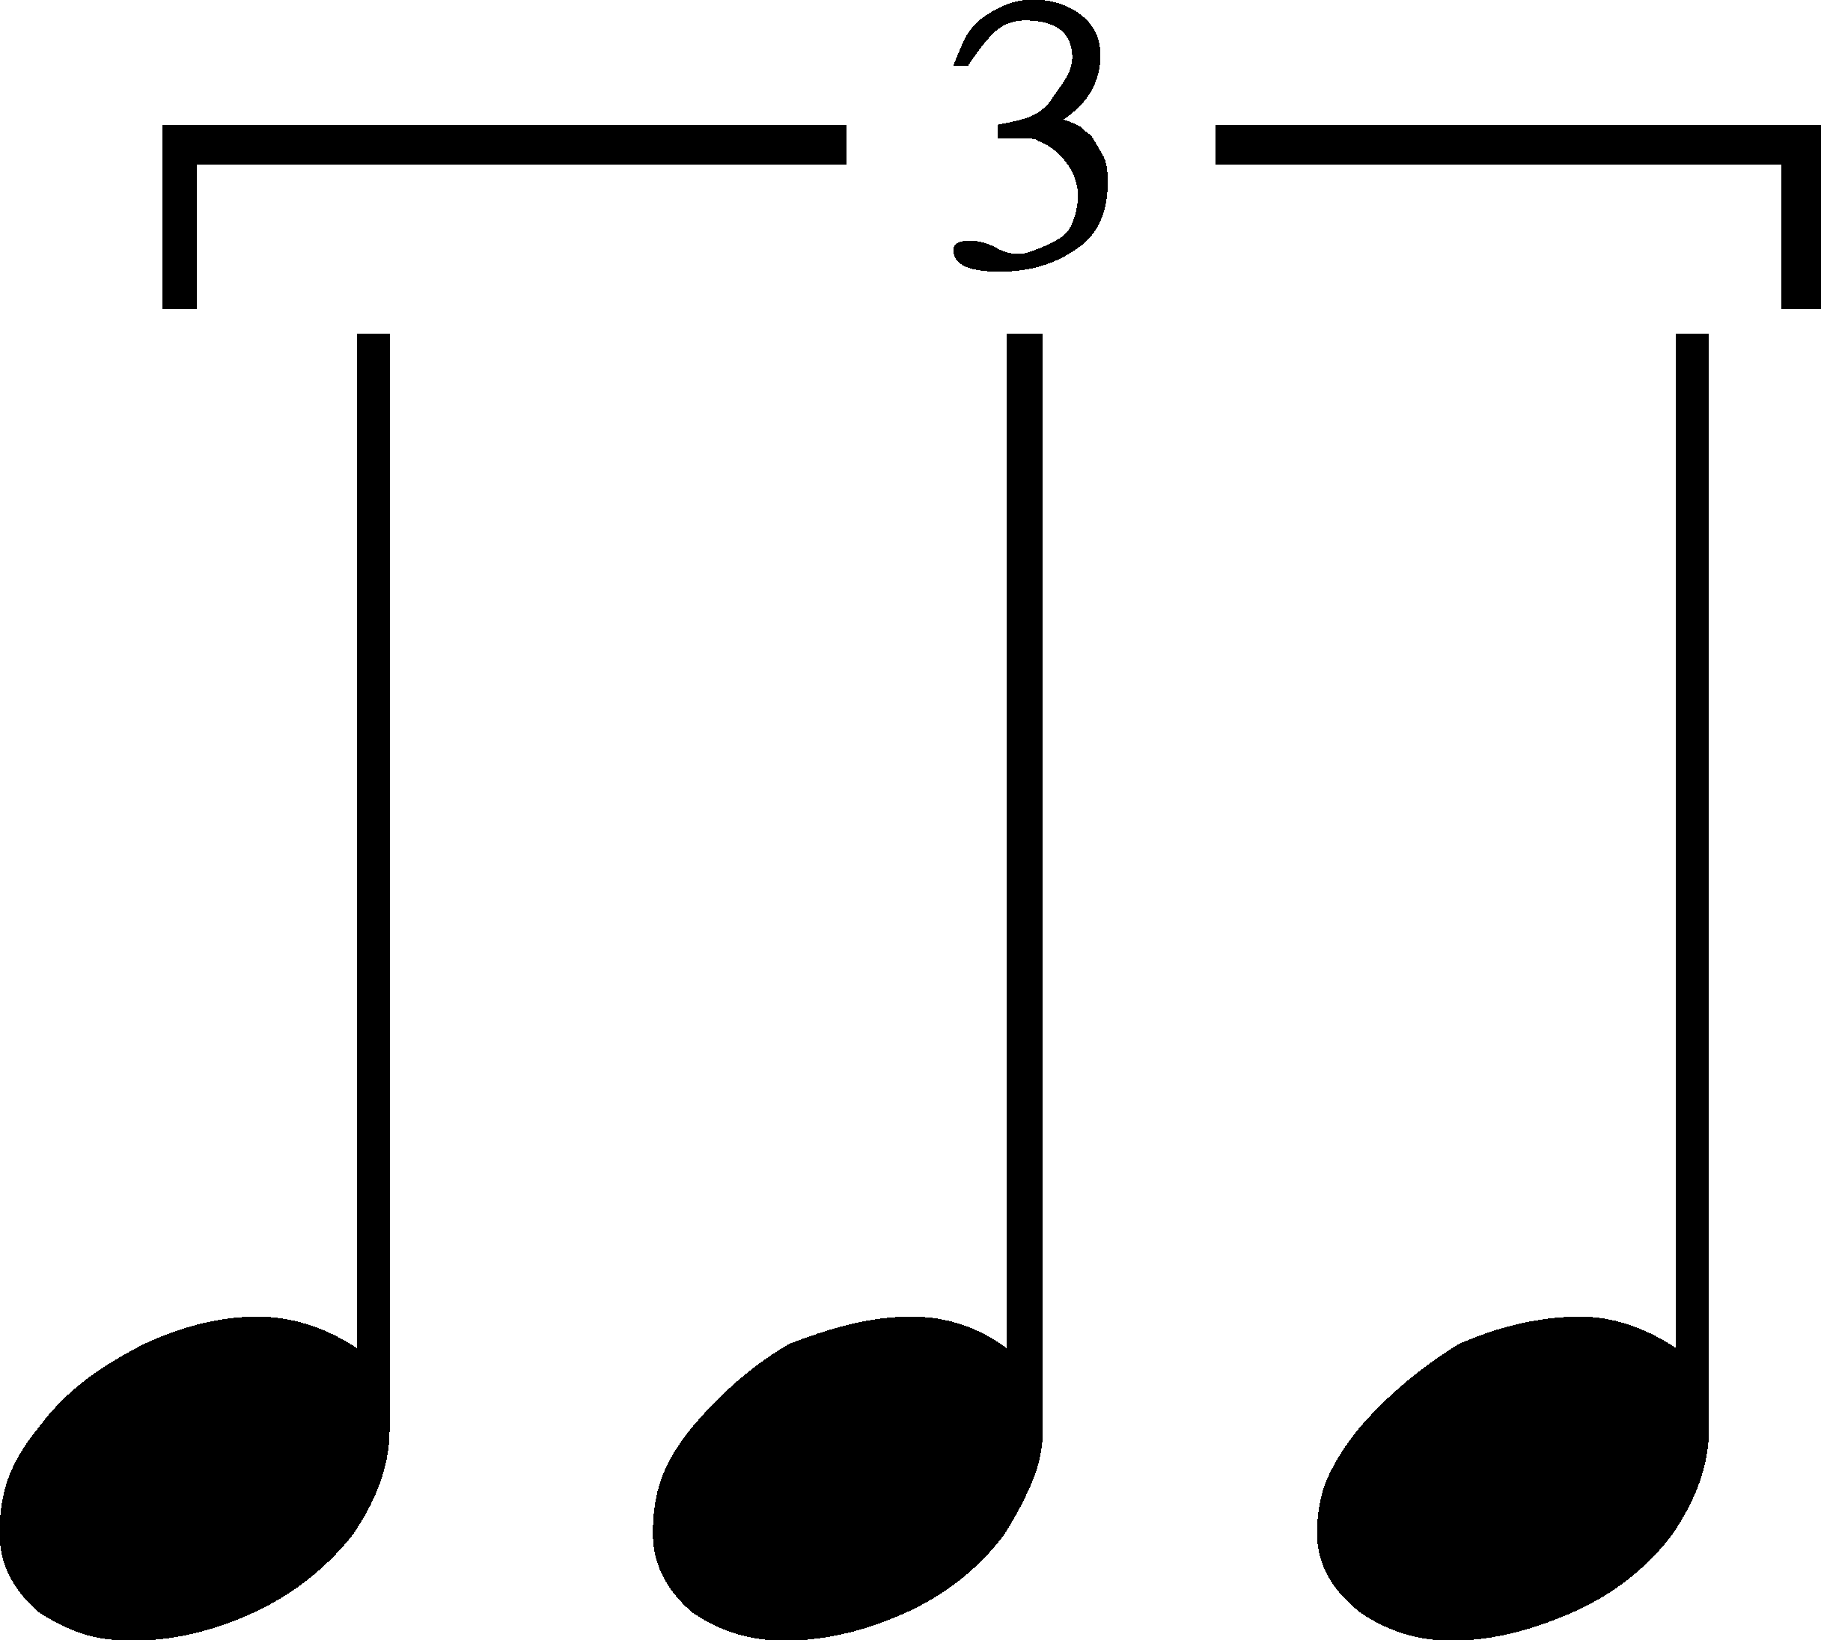
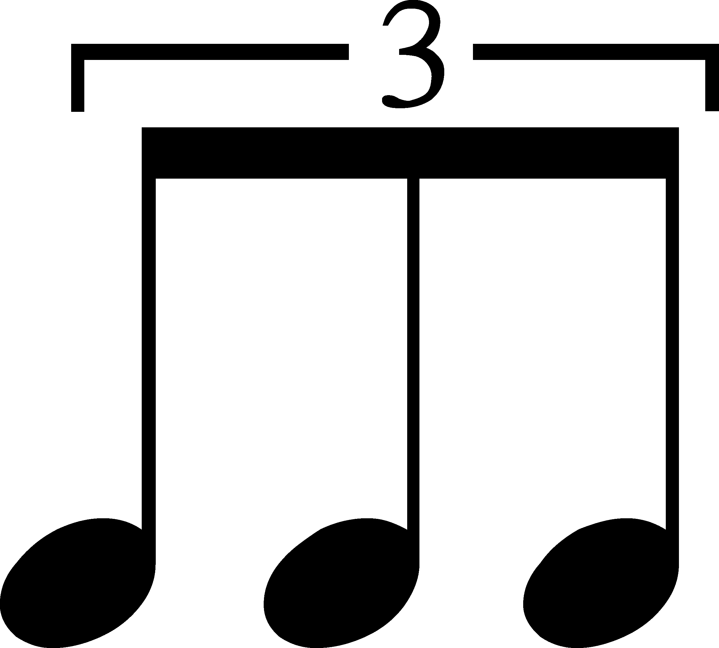
Rhythms - Notes
Whole Note = 4 beats
Half Note = 2 beats
Quarter Note = 1 beat
Pair of Eighth Note = 1/2 beat each
(1 beat total)
Eighth Note = 1/2 beat
Set of Four Sixteenth Notes = 1/4 beat each
(1 beat total)
Sixteenth Note = 1/4 beat
Dotted Quarter Note = 1+ 1/2 beats
Dots beside a note add half of the note’s original value!
Dotted Half Note = 3 beats
Quarter Note Triplets = 2 beats total
Eighth Note Triplets = 1 beat total

Slide 8
Note Value Tree

Slide 9
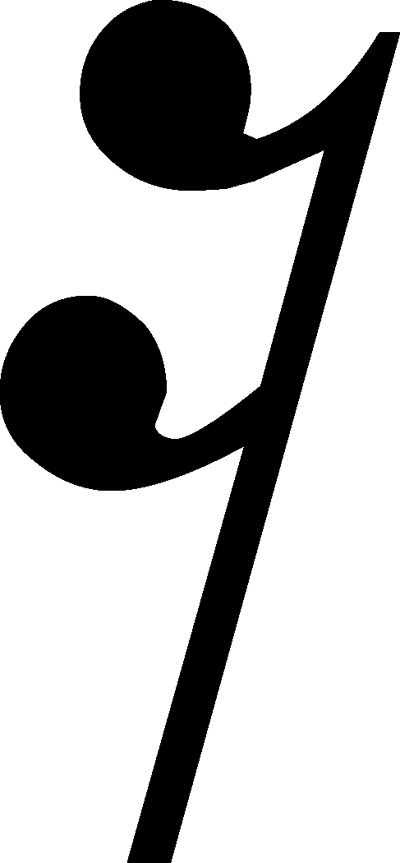
Rhythms - Rests
Whole Rest = 4 beats silence
Half Rest = 2 beats silence
Quarter Rest = 1 beat silence
Eighth Rest = 1/2 beat silence
Sixteenth Rest = 1/2 beat silence

Slide 10
Rest Value Tree

Slide 11
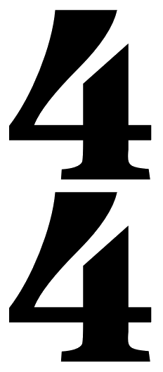
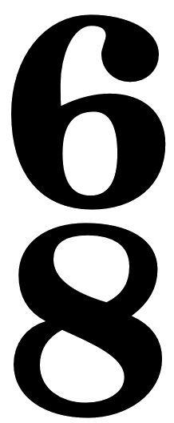
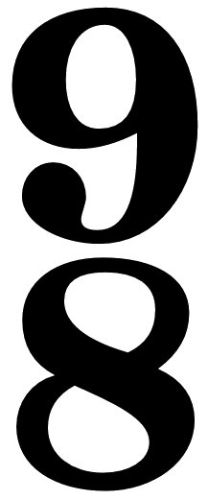
Time Signatures
The TOP number tells you how many beats there are per bar.
The BOTTOM number tells you what kind of note gets one beat.
Four beats per bar.
Three beats per bar.
Two beats per bar.
Quarter note gets one beat.
Quarter note gets one beat.
Quarter note gets one beat.
Six beats per bar. (Feels like two big beats.)
Two beats per bar. (Feels like a fast 4/4.)
Nine beats per bar. (Feels like three big beats.)
Eighth note gets one beat.
Eighth note gets one beat.
Half note gets one beat.
Stands for “common time” which is 4/4.
Stands for “cut common time” which is 2/2.)

Slide 12
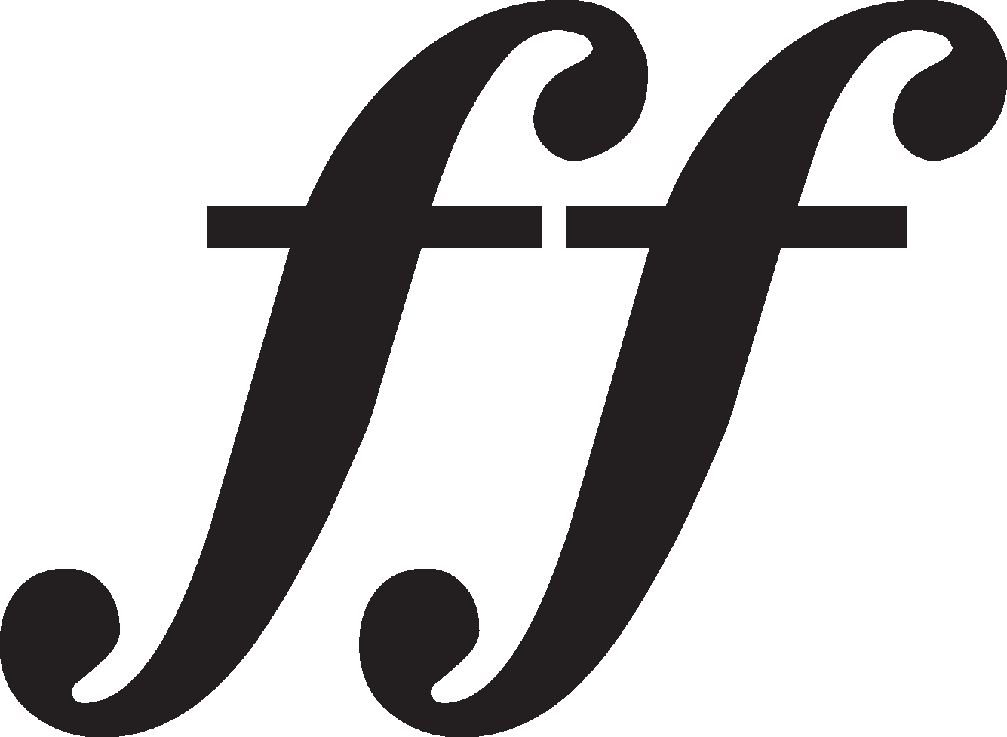
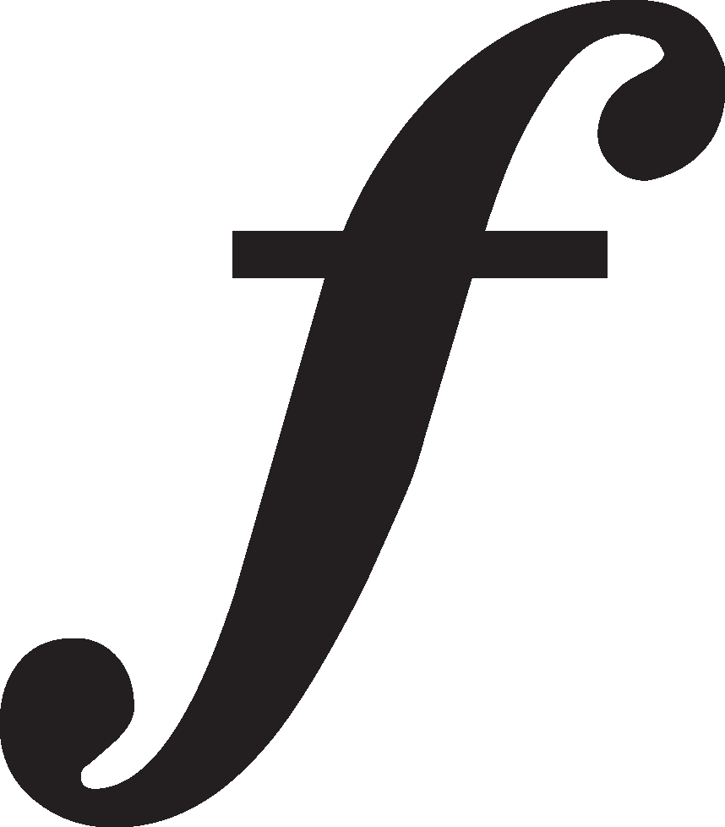
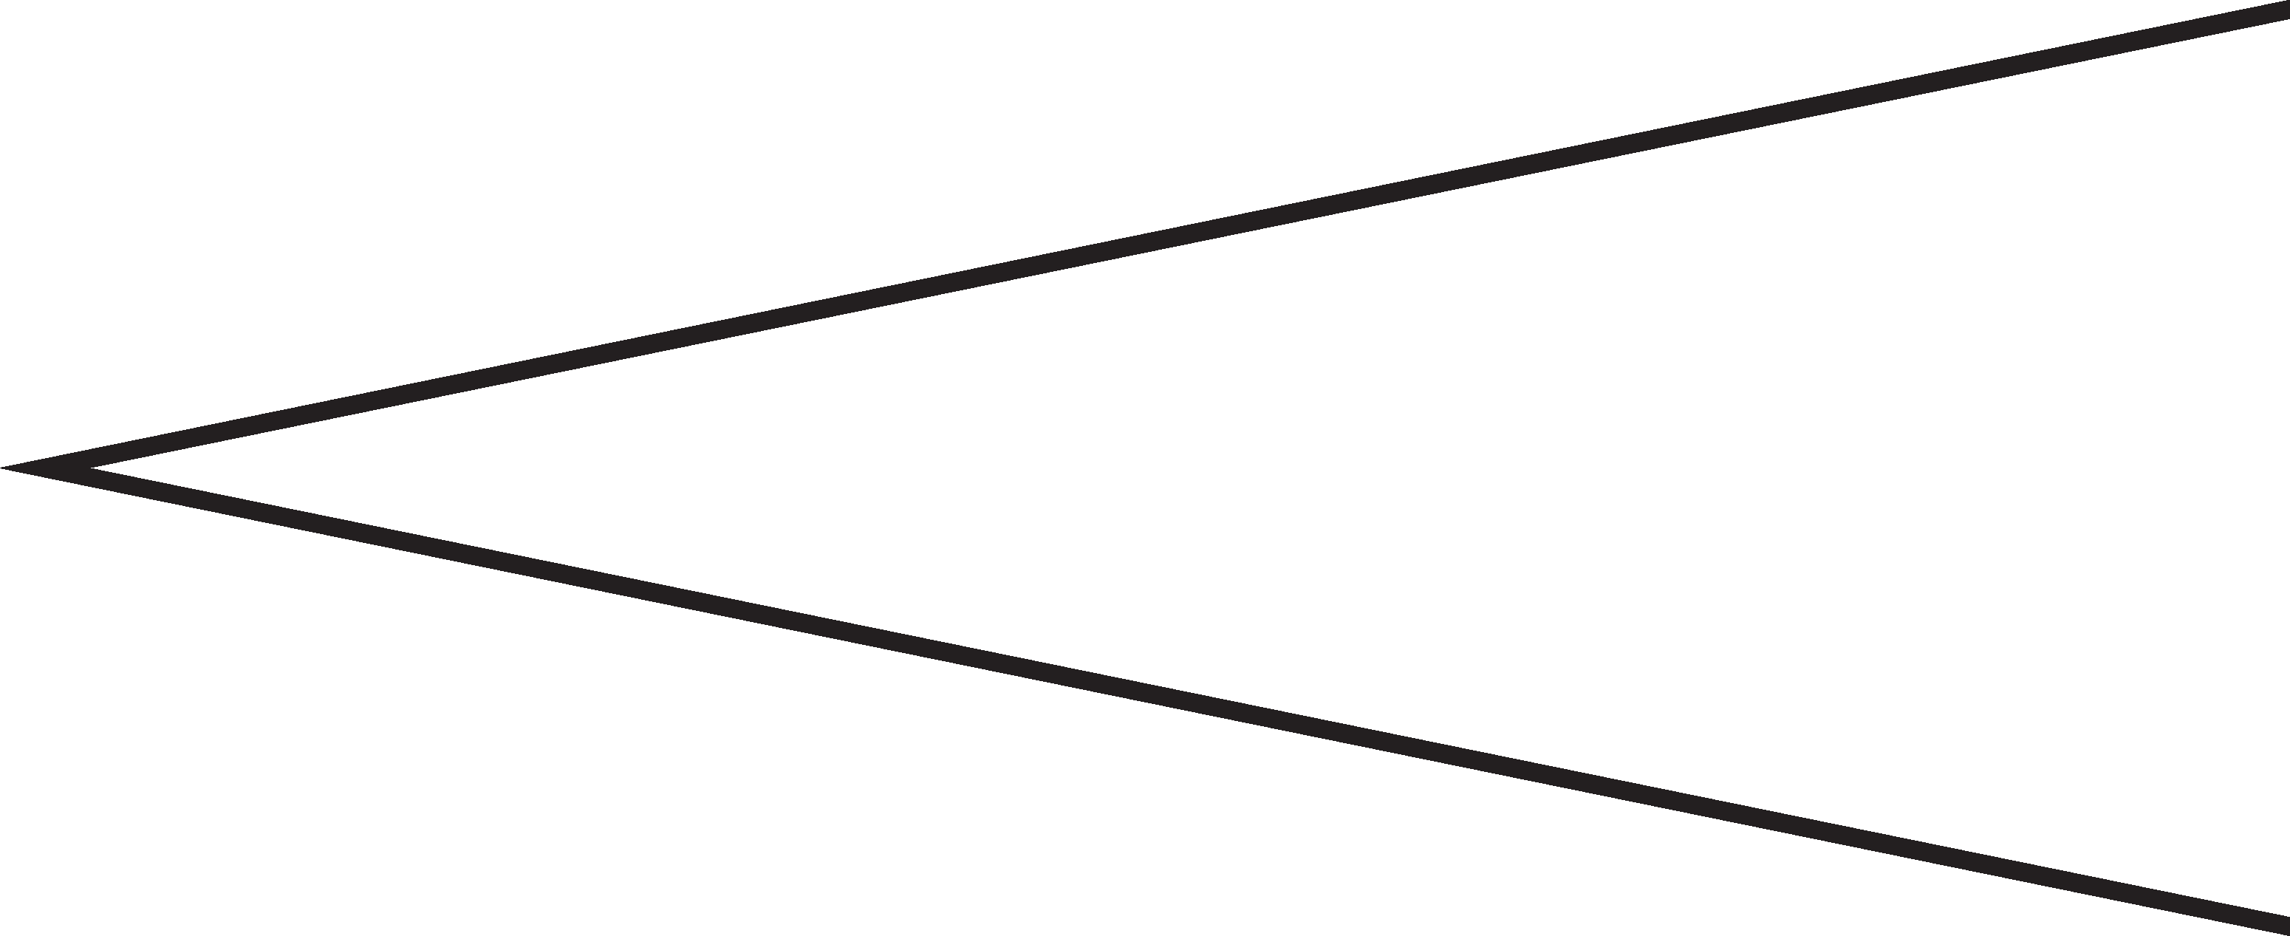
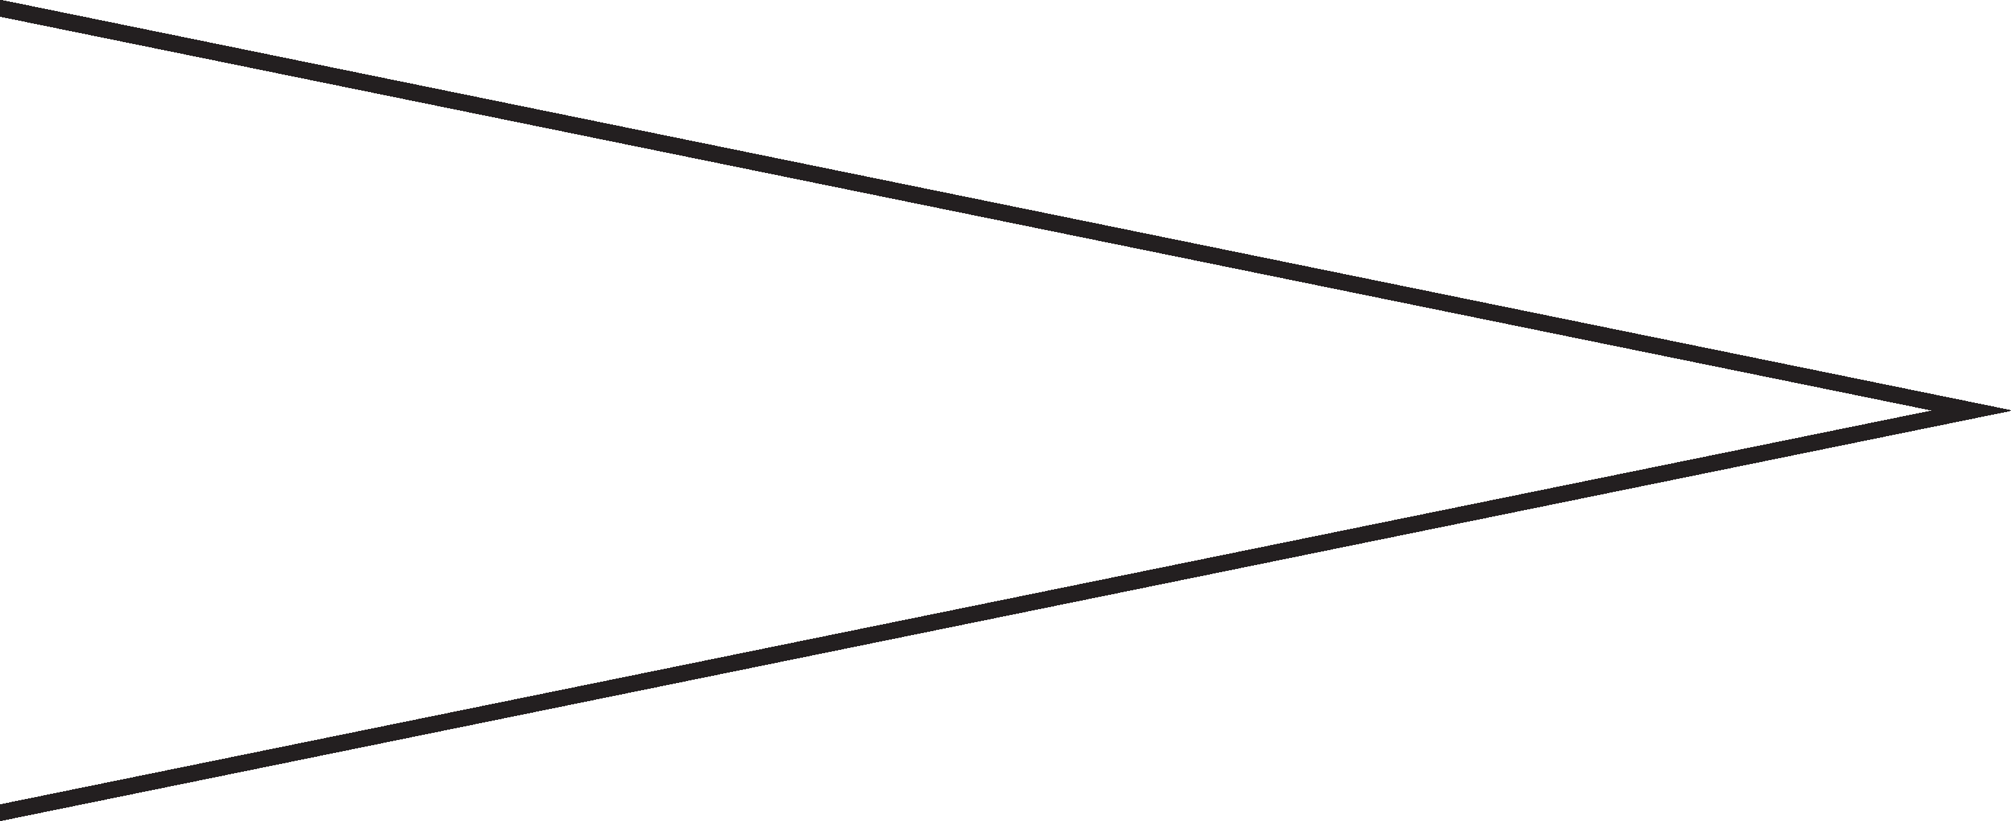
Dynamics
Fortissimo – Very Loud
Forte – Loud
Mezzo-Forte – Moderately Loud
Mezzo-Piano – Moderately Soft
Piano – Soft
Pianissimo – Very Soft
Crescendo – A gradual increase in dynamics (getting louder)
Decrescendo (Diminuendo) – A gradual decrease in dynamics (getting softer)

Slide 13
The Sound Pyramid

Slide 14
How to Use A Tuner
*If you sound too high you are SHARP (make your instrument larger)
*If you sound too low you are FLAT (make your instrument smaller)

Slide 15
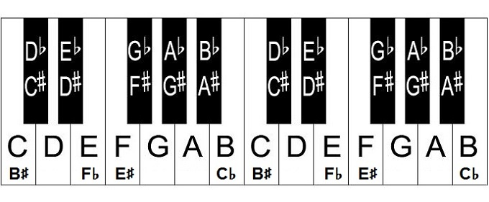
The Keyboard
*A semitone is when you move one single step away in either direction.
*A whole tone is when you move two steps away in either direction.
*Pitches that sound the same but are “spelled” differently are called enharmonics (e.g. C# and Db are enharmonics)

Slide 16
Tempo
*Tempo refers to the speed of music.
Term | Abbreviation/Symbol | Definition
Accelerando | accel. | Gradually getting faster
Allegro |  | Quick and lively
Andante |  | Moderate walking speed
A tempo |  | Return to the original tempo
Largo |  | Very slow
Ritardando | rit. or ritard. | Gradually slowing down

Slide 17
Articulation
*Articulation refers to the way notes are attacked and spaces between the notes.
Term | Abbreviation/Symbol | Definition
Accent |  | A note performed with emphasis or stress.
Legato |  | Smooth, connected style of articulation.
Slur |  | A curved line above or below notes, tells you to play legato.
Staccato |  | A detached, disconnected style of articulation.
Tenuto |  | Hold the notes for their full value.

Slide 18
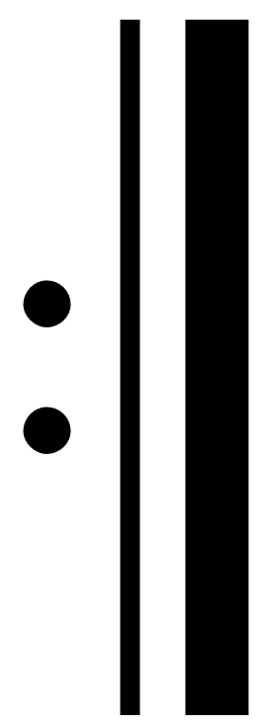
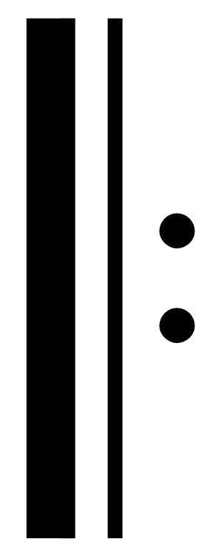
Form Symbols
Term | Abbreviation/Symbol | Definition
Repeat Sign |  | Go back to the start of the music, or to the “start repeat sign” if there is one.
Start Repeat Sign |  | Return to this spot once you come to a repeat sign.
Double Bar Line |  | Used to show the end of a section of music and the beginning of a new one.
Bar Line |  | Used to separate bars (AKA measures) of music.
Final Bar Line |  | Used to show that the piece is over.
Single Bar Repeat |  | Repeat the previous bar.
Double Bar Repeat |  | Repeat the previous two bars.
Segno |  | Go to this spot when the music says “D.S.” or “Dal Segno”.
Coda |  | A coda is an ending section. Go to this spot when the music says “To Coda”.

Slide 19
Form Symbols
Term | Abbreviation/Symbol | Definition
Fine |  | Fine means “the end” of the piece. You’ll usually see this along with a “D.S” or “D.C”.
Dal Segno al Fine | D.S. al Fine | Go back to the “segno” and play until it says “Fine”.
Dal Segno al Coda | D.S al Coda | Go back to the “segno”, play until it says “to coda”, then jump to the coda.
Da Capo | D. C. | Da Capo means the beginning of the piece.
Da Capo al Fine | D.C. al Fine | Go back to the beginning of the piece and play until it says “Fine.”
Da Capo al Coda | D.C. al Coda | Go back to the beginning o the piece, play until it says “to coda”, then jump to the coda.
1st and Second Endings |  | Play the first ending, go back to the start (or start repeat sign). This time skip the first ending and go to the second ending.

Slide 20
Form Types
*Form refers to the overall structure of music. Its “roadmap”.
Term | Definition
12-Bar Blues | An African-American song form characterized by a 12-bar structure in 4/4, use of blues notes, three-line verses, and I-IV-V harmonic progression
ABA Form | A form with three distinct parts in which a theme is followed by a contrasting theme and ends with a repeat of the original theme
AB form | A form with two distinct parts in which a theme is followed by a contrasting theme
Call and Echo | A form in which a musician ‘calls” a phrase, while another musician/group responds by imitating the same phrase
Call and Response | A form in which a musician “calls” a phrase, while another musician/group responds with a related phrase

Slide 21
Notes

Slide 22
Notes

