Slide 1
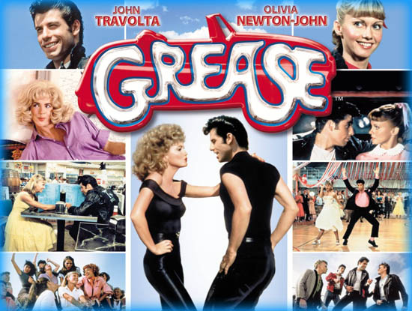
We Go Together
Warren Casey and Jim Jacobs

Slide 2
Premiered in 1971
Set in the 50s

Slide 3
We go together, like rama-lama-lama, ka dingity ding ding de dong.
Remembered forever as shoo bop sha wad da wad da yippity boom de boom.
Chang chang changity chang shoo bop, that’s the way it should be,
Wha oooh, yeah!

Slide 4
We’re one of a kind, like dip da dip da dip doo wop a doo bee doo.
Our names are signed boogedy boogedy boogedy boogedy shooby do wop sha bop.
Chang chang changity chang shoo bop, we’ll always be like one.
Wa wa wa waaaaah!

Slide 5
When we go out at night,
And stars are shinin’ bright
Up in the skies above.
Or at the high school dance,
Where you can find romance,
Maybe it might be lo-uh-uh-uh-uh-uh-love

Slide 6
Rama lama lama ka digity ding de dong.
Shoo bop sha wadda wadda yippity boom de boom.
Chang chang changity chang shoo bop.
Dip da dip da dip doo wop a doo bee doo.

Slide 7
Boogedy boogedy boogedy boogedy shooby doo wop sha bop.
Sha na na na na na na na yippity dip de boom.
Wop ba ba lu mop and wop bam boom.

Slide 8
We’re for each other, like wop ba ba lu mop and wop bam boom.
Just like my brother is sha na na na na na na na yippity dip de boom.
Chang chang changity chang shoo bop, we’ll always be together,
Wha ooh, yeah!

Slide 9
4 Times Through This Slide, Layer Parts
We’ll always be together.
We’ll always be together.
Chang chang changity chang shoo bop.
Chang chang changity chang shoo bop.
Chang chang chagity chang shoo bop.
Chang chang changity chang shoo bop.
Ooooooh
Ooooooh

Slide 10
Oooooh,
Oo.

