Slide 1
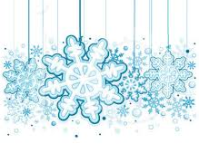
Snowflakes
Arranged by A. Miller

Slide 2
Snowflakes falling softly in the night.
Snowflakes make such a beautiful sight
When they’re falling in the night
Underneath the shimmering light.
Winter time is sure lots of fun.
I’m so happy that winter has begun!
We can ski and sled and skate.
I’m so excited that I can hardly wait.

Slide 3
Dashing through the snow
In a one horse open sleigh
O’er the fields we go
Laughing all the way.
Bells on bobtail ring
Making spirits bright
What fun it is to ride and sing
A sleighing song tonight!

Slide 4
Oh! Jingle bells, jingle bells,
Jingle all the way!
Oh what fun it is to ride in a one horse open sleigh.
Hey!
Jingle bells, jingle bells,
Jingle all the way!
Oh what fun it is to ride in a one horse open sleigh!

