Slide 1
My Paddle
Canadian Folk Song

Slide 2
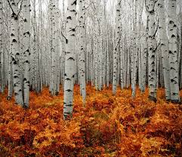
Land of the silver birch,
Home of the beaver,
Where still the mighty moose
Wanders at will.
Blue lake and rocky shore,
I will return once more.
Boom di-di boom boom
Boom di-di boom boom
Boom di-di boom boom boom.

Slide 3
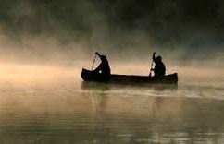
My paddle’s keen and bright,
Flashing with silver!
Follow the wild goose flight,
Dip dip and swing.
Dip dip and swing her back,
Flashing with silver,
Follow the wild goose flight,
Dip dip and swing.

Slide 4
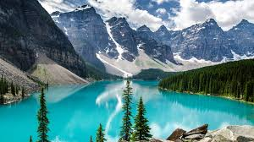
High on a rocky ledge,
I’ll build my wigwam
Close by the water’s edge,
Silent and still.
Blue lake and rocky shore,
I will return once more.
Boom di-di boom boom
Boom di-di boom boom
Boom di-di boom boom boom.

Slide 5
Land of the Silver Birch
Canadian Folk Song

