Slide 1
Starting the Trumpet

Slide 2
Recordings
https://www.youtube.com/watch?v=ZUZYoVw7moc
https://www.youtube.com/watch?v=TwN5IfQGoOI

Slide 3
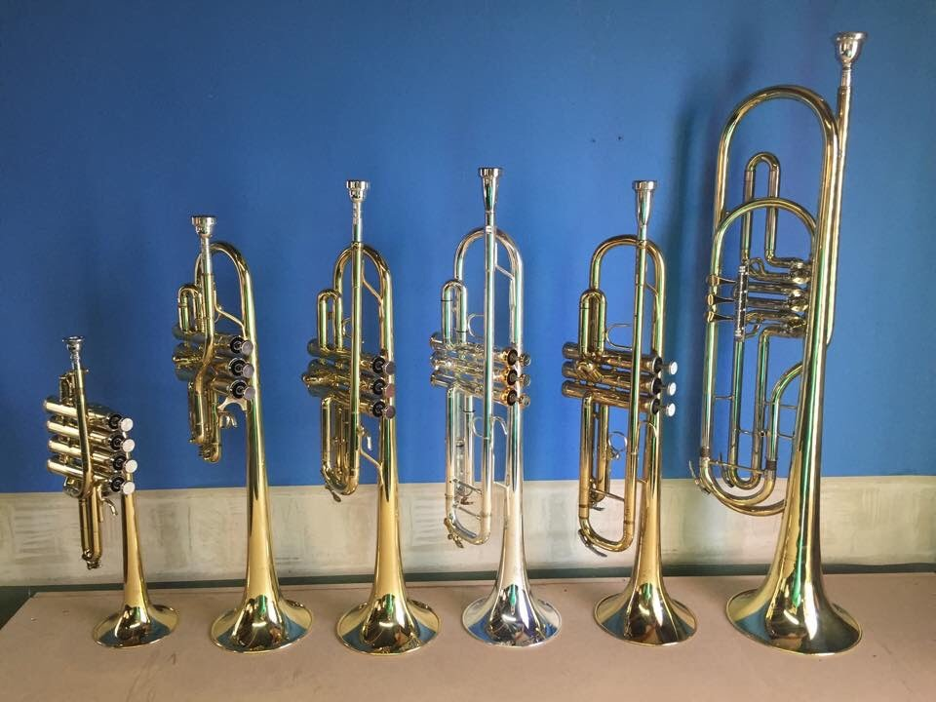
Trumpet Basics
Part of the brass family
Forms of the trumpet have been around since about 1500 B.C.
You produce by buzzing your lips against the mouthpiece.
You change the pitch by pressing different valve combinations and by adjusting your air stream.
The most common trumpet is a “B-flat Soprano Trumpet”, but there are others too.

Slide 4
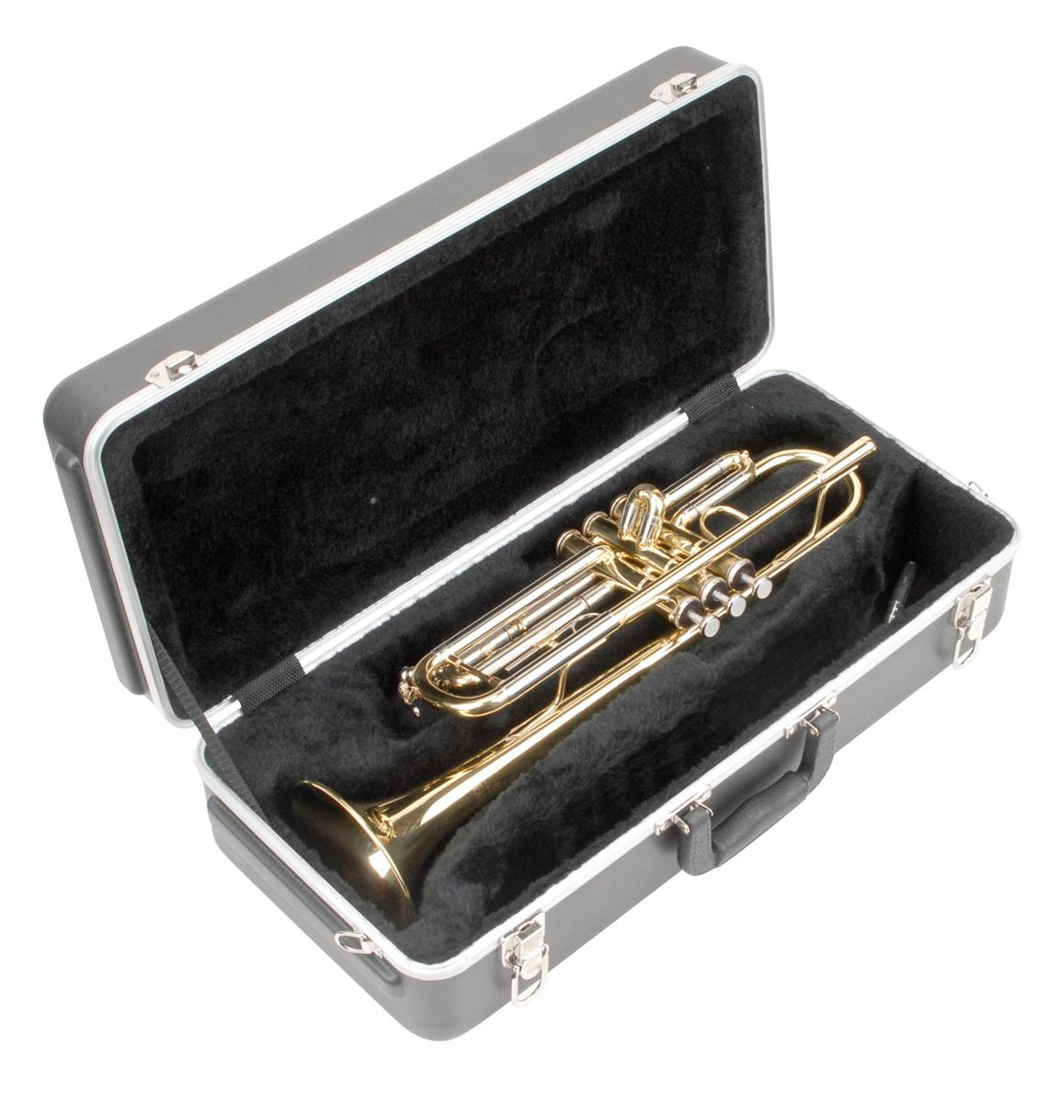
Opening Your Case
Put your case on the floor with the case’s logo facing up.
Check that all the necessary parts are in your case:
Trumpet
Mouthpiece
Other Things (optional): Polishing Cloth, Valve Oil
Any garbage or books in your case? Let’s clean them out.

Slide 5
Important!
DO NOT pull pieces off the trumpet. You can damage the metal.
DO NOT hit your mouthpiece into the instrument.
Be very careful not to drop the instrument or the mouthpiece.
You’re holding around $500 in your hand. Respect it.

Slide 6
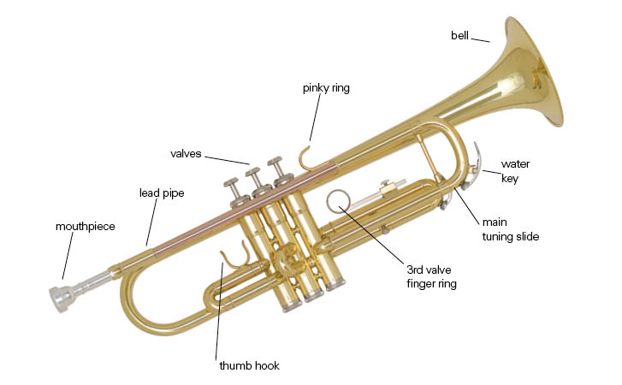
Assembly
Hold the instrument in your left hand.
Use your right hand to place the mouthpiece into the lead pipe.
Gently turn the mouthpiece slightly to the right to secure it. Do not press it straight down – mouthpiece can get stuck!
You will learn how to oil your valves later.

Slide 7
Disassembling the Trumpet
Press the water key (“spit valve”) and gently blow into the instrument to drain excess water.
Remove the mouthpiece.
Put the trumpet carefully back into it’s case. It only fits in the case one way! – Do not force it closed.

Slide 8
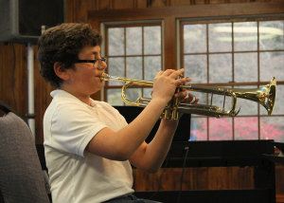
Holding the Trumpet
Sit up tall on the edge of your chair. Feet flat on the floor.
Hold the trumpet in your left hand. Wrap your fingers around the valves.
Place your left middle finger in the third valve ring.
Place your right thumb between the first and second valves, just below the lead pipe.
Place the tips of your right hand fingers on top of the valves. Fingers should be curved and relaxed.
Place your right hand pink on top of the “pinky ring” (not in it).
Elbows should be away from the body.

Slide 9
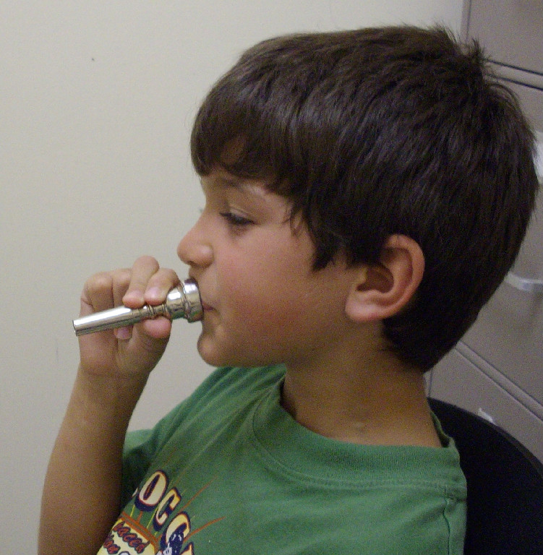
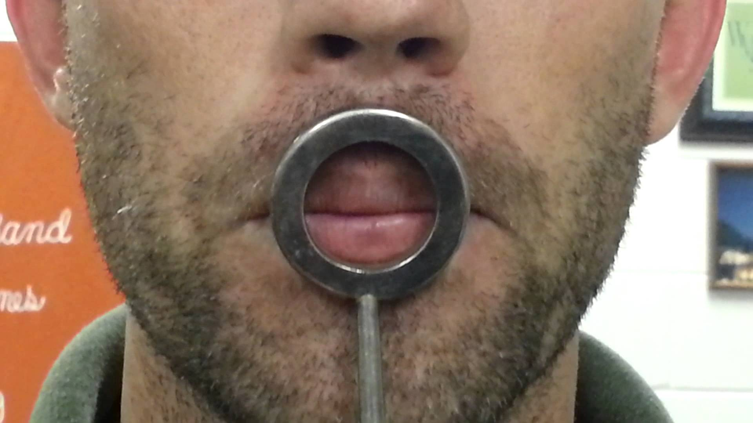
Making a Sound
Shape the inside of your mouth like you’re saying “oh”, but your lips like they’re saying “em”.
Lips should have firm corners but a relaxed center.
Chin should be flat.
Place just the mouthpiece against your lips with equal pressure on the upper and lower lips.
Take a deep breath of air and blow so that your lips buzz together. Start the sound with your tongue by saying “too”.
When you are comfortable with just the mouthpiece, add the rest of the instrument.
The first notes you should get will be either a “C” or a “G”

Slide 10
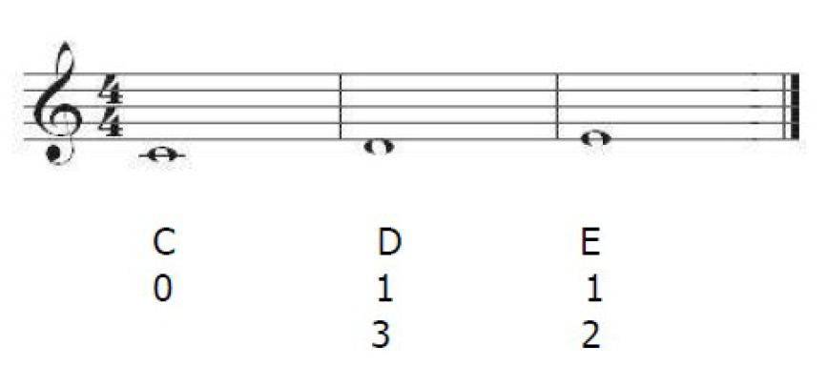
First Notes
The first notes we’ll play will be E, D, and C.
Hot Cross Buns:
E D C
E D C
C C D D
E D C

Slide 11
Merrily We Roll Along
E D C D E E E
D D D
E E E
E D C D E E E
D D E D C

Slide 12
Mary Had a Little Lamb
E D C D E E E
D D D
E G G
E D C D E E E
D D E D C

Slide 13
Au Claire de la Lune
C C C D E D
C E D D C
C C C D E D
C E D D C

Slide 14
Lightly Row
G E E F D D
C D E F G G G
G E E F D D
C E G G C

