Slide 1
Starting the Flute

Slide 2
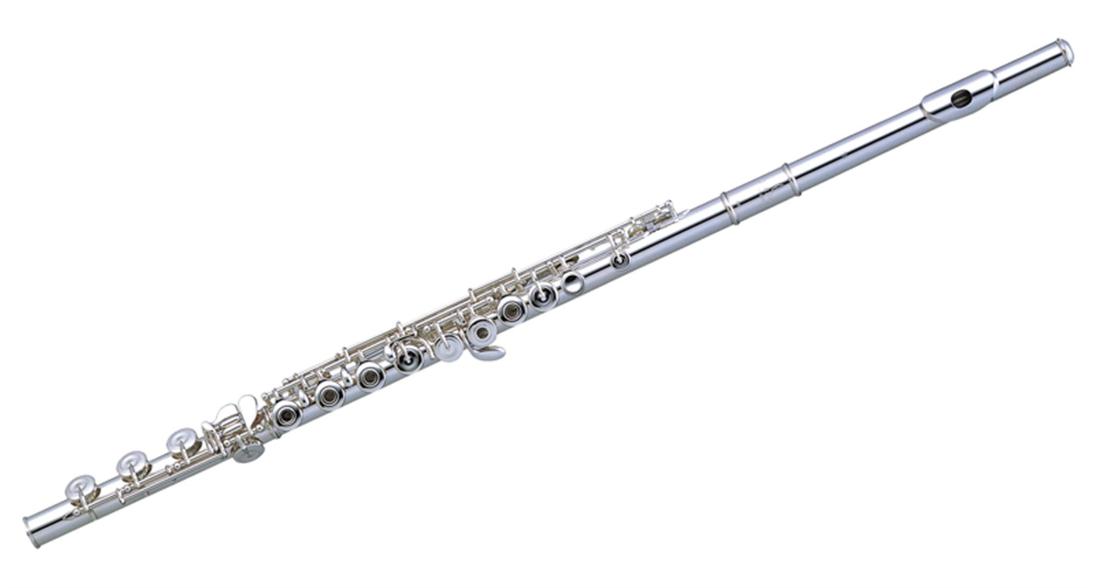
Recordings
https://www.youtube.com/watch?v=QqIPJZ70khc
https://www.youtube.com/watch?v=8zPkWVqdJXI
https://www.youtube.com/watch?v=2znYwIaYzkM

Slide 3
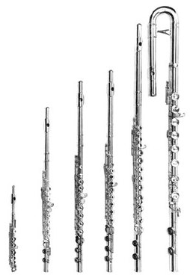
Flute Basics
Part of the woodwind family
One of the oldest instruments
No reed – you blow across the instrument instead

Slide 4
Opening Your Case
Put your case on the floor with the case’s logo facing up.
Check that all the necessary parts are in your case:
Head joint
Foot Joint
Body

Slide 5
Important!
Each part will twist together. If it isn’t going in easily, ask for help please.
It’s easy to damage the tenons (where the parts connect).
Like the clarinet, always try and hold/twist where there aren’t rods/keys.

Slide 6
Assembly
Connect the foot joint to the body so that they keys line up (not the rods).
Connect the head joint to the body with the lip plate lined up with the keys.

Slide 7
Disassembling
Remove the head joint and shake out any excess water.
Separate the body and foot joints.
Put each piece carefully back in it’s case. Each piece fits in in a specific way – do not force anything.

Slide 8
Holding the Flute
Sit up tall on the edge of your chair. Feet flat on the floor.
Your left hand will hold the body.
Thumb goes on the longer key on the back.
“Skip one, yes, skip one, yes, yes”
Your right hand uses the keys closer to the foot.
“Pinky, yes, yes, yes”
Thumb rests under the flute between your pointed and middle fingers.
Your fingers should feel relaxed and curved. Elbows away from the body.
Hold the flute up to your lips, parallel to the ground.

Slide 9
Making a Sound
We’ll start with just the headjoint.
Pouty “poo” lips.
Place the head joint on your chin so the embouchure hole is against your lower lip.
Blow across the embouchure hole as if blowing across a pop bottle.
Start the air stream with a “too” with your tongue and let the air stream separate your lips.
You want the hold between your lips to be small so that your airstream is small and focused.

Slide 10
Hot Cross Buns
D C Bb
D C Bb
Bb Bb C C
D C Bb

