Slide 1
Starting the Clarinet

Slide 2
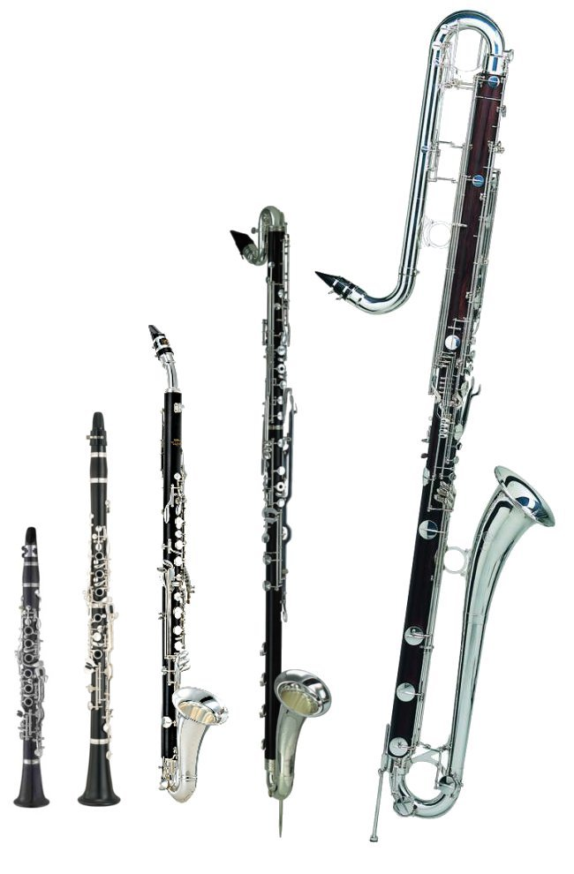
Recordings
https://www.youtube.com/watch?v=o_gm0NCabPs
https://www.youtube.com/watch?v=eFHdRkeEnpM

Slide 3
Groups
Group 1
Group 2
Kylan
Celia
Amy
Daniel
Cadence
Nathan
Michaela
Leiland
Jalen
Connor
Nevaeh
Zach
Natalie
Owen
Brayden
Allie
Jonny
Jenna
Averey
Ben
Patrick

Slide 4
Clarinet Basics
Part of the woodwind family
Invented in Germany in the 17th Century
The “Soprano Clarinet” is the most common, but there are also contra-bass clarinets, bass clarinets (our school has these), alto clarinets, and E-flat clarinets
Sound is produced by a vibrating reed
Reeds cost money – please be very careful with them and keep them in a safe place. I will not replace reeds for people who are being careless.

Slide 5
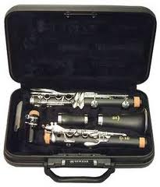
Opening Your Case
Put your case on the floor with the case’s logo facing up.
Check that all the necessary parts are in your case:
Bell
Lower Joint
Upper Joint
Barrel
Mouthpiece
Other Things (optional): Mouthpiece cap, cleaning cloth, cork grease

Slide 6
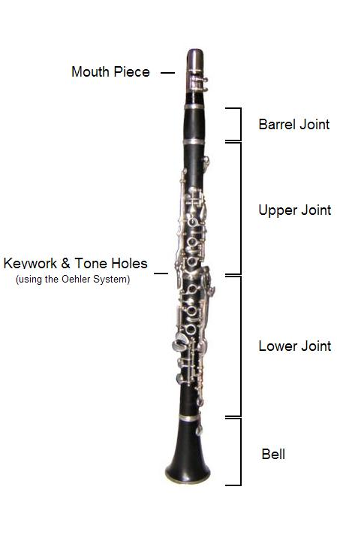
Important!
Clarinets are the most difficult band instrument to put together.
When assembling your clarinet – always hold the parts where you aren’t going to twist or bend any rods/keys.
Never force pieces together – if they’re not going, something is wrong. (You might just need some cork grease.)
Never stand your clarinet up on its bell – they fall over easily!
Before you start, sanitize your mouthpiece.
1-2 spritzes and a small piece of paper towel is all you need – more than this and you’re being wasteful.

Slide 7
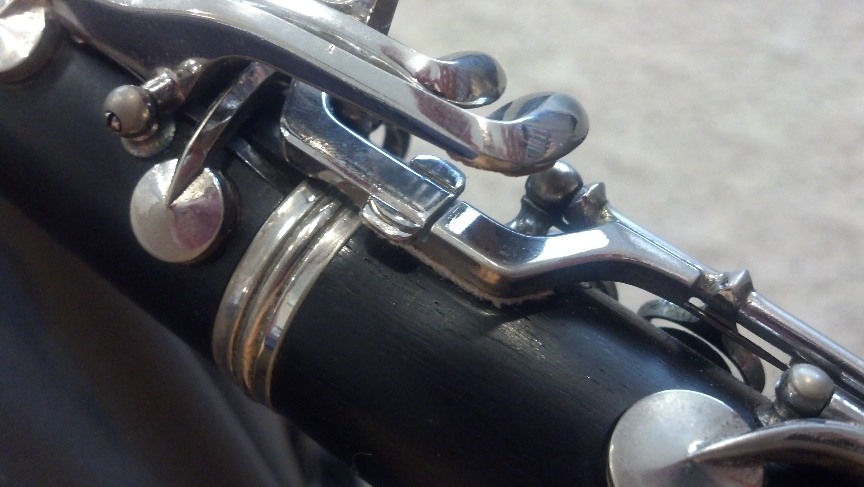
Assembly
Hold the bell in your left hand and the lower joint in your right hand. Gently twist them together, making sure to hold on to the joints where you aren’t twisting keys/rods.
Hold the upper joint in your right hand, pressing down the rings with your fingers. Gently twist it on to the lower joint. The “Bridge Keys” should line up.

Slide 8
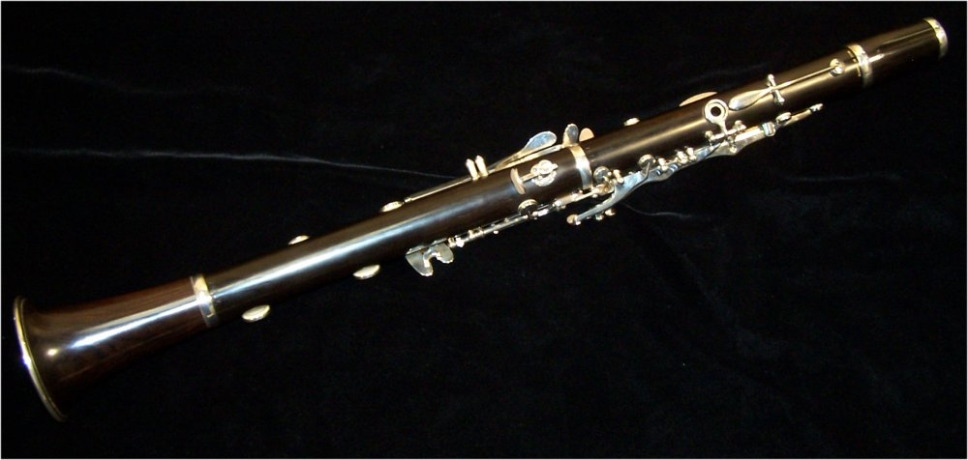
Assembly
Twist the barrel onto the upper joint.
Remove the ligature from the mouthpiece and then twist the mouthpiece onto to the barrel. The flat part of the mouthpiece will be towards the back of the clarinet.
Slide the ligature back onto the mouthpiece. The big end of the screws will always be on the right. Do not force the ligature on.

Slide 9
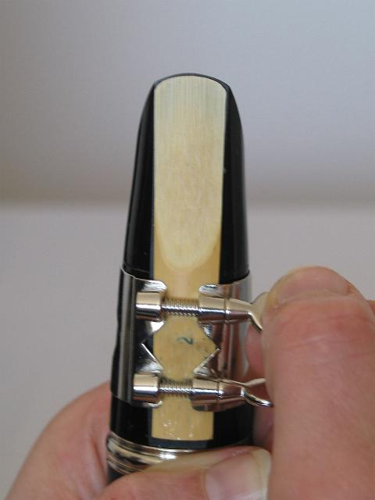
Putting on The Reed
Soak your reed in your mouth. (Once you get comfortable with assembling the clarinet, you can do this while you put it together.)
With hand, push the ligature slightly up.
Slide the reed beneath the ligature until the tip of the reed matches the tip of the mouthpiece. DO NOT TOUCH THE TIP OF THE REED – ADJUST IT FROM THE BOTTOM AND SIDES! (The flat part of the reed goes against the mouthpiece.)
Tighten the ligature screws just until they are snug – no more.
Gently put your mouthpiece cap on (if you have one) to protect the reed.

Slide 10
Disassembling the Clarinet
Start with by taking the reed off and carefully sliding it back into it’s plastic holder. Be very careful doing this! – Start with the thick end.
If you have a cleaning swab, drop the weighted end through the bell and pull it out the other end. Repeat this 2-3 times.
Take the pieces off in the opposite way you put them on. Be careful to hold where you aren’t twisting or bending rods/keys.
As you go, place each of the piece back into the case. Each piece has a specific place to go – do not force pieces or you will end up bending them.
Latch your case and you’re good to go! Do not leave your reed in the case.

Slide 11
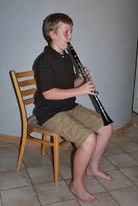
Holding the Clarinet
Sit up tall on the edge of your chair. Feet flat on the floor.
Put your right hand thumb underneath the thumb rest.
Put your left hand on the upper joint – thumb goes on the ring on the back, and first three fingers cover the rings on the front.
Hold the clarinet directly in front of you, between your knees, at about a 45 degree angle away from your body.
Your fingers should feel relaxed and curved. Elbows away from the body.

Slide 12
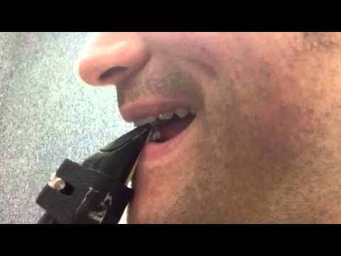
Making a Sound
We’ll start with just the barrel and the mouthpiece.
Cushion your bottom teeth with your bottom lip. (“No teeth face”.)
Place the mouthpiece in your mouth at a downward angle, about to where the reed actually touches the mouthpiece.
Your top teeth will rest directly on the mouthpiece.
Close your mouth like a drawstring around the mouthpiece – equal pressure all around.
Chin should be flat (feels like you’re pulling it down.)
Take in a deep breath of air and create a long, steady tone. Start the sound by saying “too” – the tip of your tongue will touch the reed when you do this.

Slide 13
First Notes
Holding the clarinet should feel somewhat similar to holding the recorder.
The first notes we’ll play will be like B-A-G songs on recorder. (Except those fingerings on the clarinet make E-D-C.)
Hot Cross Buns:
E D C
E D C
C C D D
E D C

Slide 14
Merrily We Roll Along
E D C D E E E
D D D
E E E
E D C D E E E
D D E D C

Slide 15
Au Clair De La Lune

